Slide 1
Rehabilitative Care Alliance
HNHB LHIN Hip Fracture & TJR
Self-Assessment Analysis Report
November 2018

Slide 2
Table of Contents
Overview of Self-Assessment Process Slide 3-4
Self-Assessment Participation Slides 5-9
Self-Assessment High Performers Slides 10-12
Self-Assessment Data Analysis
Analysis Overview Slide 14-16
Hip Fracture Bedded Slides 17-30
Hip Fracture Ambulatory Slides 31-41
Hip Fracture In-Home Slides 42-52
Hip Fracture Long Term Care Slides 53-63
TJR Pre-Operative Care Slides 64-75
TJR Bedded Slides 76-87
TJR Ambulatory Slides 88-98
TJR In-Home Slides 99-109
Summary Slides 110-113
Appendix A: Provincial Pareto Diagrams Slides 114-130

Slide 3
Overview of Self-Assessment Process
The Rehabilitative Care Alliance (RCA) released two best practice frameworks in 2017:
Rehabilitative Care Best Practices Framework for Patients with Hip Fractures
Rehabilitative Care Best Practices Framework for Patients with Primary Hip and Knee Replacements
The frameworks support implementation of QBPs with detailed best practices for rehabilitative care across all care settings: pre-operative (TJR), bedded, ambulatory, in-home and long-term care (hip). Quick reference guides for each setting provide a concise summary of best practices to guide clinical practice.

Slide 4
Overview of Self-Assessment Process (2)
The Rehabilitative Care Alliance undertook a provincial self-assessment process which allowed health service providers to determine how well their current care aligns with best practices set out in the RCA's rehabilitative care best practice frameworks for hip fracture and primary hip and knee replacements.
Self-assessment tools were released in January to health service providers with a deadline of May 4, 2018. This deadline was extended to ensure that all organizations had the opportunity to complete their self-assessments. Final self-assessments were received July 13, 2018.
The RCA received 247 self-assessments (116 Hip Fracture/131 TJR) from 104 organizations across all 14 LHINs.

Slide 5
Self-Assessment Participation

Slide 6
Provincial participation in self-assessment
Total Number of Organizations | 104
Total Number of Hip Fracture Assessments | 116
Total Number of TJR Assessments | 131
Data received as of July 17, 2018

Slide 7
Number of organizations by LHIN
Central | 3 | Erie St. Clair | 2
Central East | 4 | Waterloo Wellington | 7
Toronto Central | 10 | Champlain | 9
Central West | 2 | North Simcoe Muskoka | 2
South West | 10 | HNHB | 19
North East | 5 | Mississauga Halton | 4
North West | 17 | South East | 7
MultiLHIN | 3 | TOTAL | 104
Data received as of July 17, 2018

Slide 8
Number of Hip Fracture Self-Assessments by LHIN
Total: 116
Total Bedded: 51
Total In Home: 21
Total Ambulatory: 23
Total LTC: 21
Data received as of July 17, 2018

Slide 9
Number of TJR Self-Assessments by LHIN
Data received as of July 17, 2018

Slide 10
Self-Assessment High Performers

Slide 11
Self-Assessment High Performers
Those who were named high performers were all or mostly aligned with hip fracture or total joint replacement best practices on their self-assessments
Best practice implementation strategies from the high performing programs in each sector are shared below to promote knowledge exchange

Slide 12
High Performers – All or Mostly Aligned
Hip Fracture
Bedded
Halton Healthcare
Grand River Hospital
Ambulatory
Halton Healthcare
In-Home
Mississauga-Halton St. Elizabeth
LTC
Heidehof
Radiant Care Pleasant Manor
Total Joint Replacement
Pre-operative Care
St. Joseph’s Healthcare Hamilton
Halton Healthcare
Sunnybrook Health Sciences
Peterborough Regional
Queensway-Carleton
Bedded
Cambridge Memorial
Grand River Hospital
Brant Community Healthcare
Dundurn Place
Peterborough Regional
Providence Care
Queensway-Carleton
Ambulatory
Grand River Hospital
Providence Healthcare
Sunnybrook Health Sciences
Pembroke Regional
In-Home
Waterloo-Wellington LHIN

Slide 13
Self-Assessment Data Analysis

Slide 14
Analysis Overview
Heat Map:
Priorities for Improvement highlighted based on organizational best practice ratings of aligned, partially aligned or not aligned
Provincial Data Analysis
Goal Summary Analysis based on Short-Term, Mid-range and Long-Term Goals outlined by each organization
Resources Analysis based on resources requested by each organization
See Appendix A for Pareto Diagrams
LHIN specific goals and resources requested
Strengths
Provincial and LHIN specific best practices that are all or mostly aligned
Opportunities
Provincial and LHIN specific best practices that are least aligned

Slide 15
Pareto Analysis
Pareto Analysis is a method that helps to determine the most important factors that significantly affect processes
Prioritizes which issues, processes, products or services to work on first
Identifies the most significant factors (LEAN 80/20 rule – 80% of problems are caused by 20% of contributors)
In this case, we used frequency of occurrence as our unit of comparison (number of sites who identified similar factors). We could also prioritize categories based on cost, severity and timing.

Slide 16
Overview of a Pareto Diagram
Pareto Diagram Example:
The Bar Chart shows the impact of the individual categories to the overall effect
The Cumulative Line shows how the individual categories add up to the total overall effect.
The Vital Few – the contributors that will make the greatest impact on the process

Slide 17
Hip Fracture Bedded: Provincial Priorities for Improvement
LHIN | ESC (1 | SW (n=5) |  |  |  |  | WW (n=3) |  |  | HNHB (n=11) |  |  |  |  |  |  |  |  |  |  | CW (1 | MHn=2 |  | TC (n=5) |  |  |  |  | CEN n=2 |  | CE n=2 |  | SE n=2 |  | CH (n=6) |  |  |  |  |  | NSM n=2 |  | NE (n=3) |  |  | NW (n=5)
Assessment | Well Aligned | Well Aligned | Well Aligned | Well Aligned | Well Aligned | Well Aligned | Well Aligned | Well Aligned | Well Aligned | Well Aligned | Well Aligned | Well Aligned | Well Aligned | Well Aligned | Well Aligned | Well Aligned | Well Aligned | Well Aligned | Well Aligned | Well Aligned | Well Aligned | Well Aligned | Well Aligned | Well Aligned | Well Aligned | Well Aligned | Well Aligned | Well Aligned | Well Aligned | Well Aligned | Well Aligned | Well Aligned | Well Aligned | Well Aligned | Well Aligned | Well Aligned | Well Aligned | Well Aligned | Well Aligned | Well Aligned | Well Aligned | Well Aligned | Well Aligned | Well Aligned | Well Aligned | Well Aligned | Well Aligned | Well Aligned | Well Aligned | Well Aligned
Delirium/ Dementia/ Depression | Priority for Improvement | Well Aligned | Priority for Improvement | Well Aligned | Well Aligned | Priority for Improvement | Well Aligned | Well Aligned | Well Aligned | Priority for Improvement | Well Aligned | Well Aligned | Priority for Improvement | Well Aligned | Well Aligned | Well Aligned | Well Aligned | Priority for Improvement | Well Aligned | Well Aligned | Priority for Improvement | Well Aligned | Well Aligned | Well Aligned | Well Aligned | Priority for Improvement | Well Aligned | Well Aligned | Priority for Improvement | Well Aligned | Well Aligned | Well Aligned | Well Aligned | Well Aligned | Well Aligned | Well Aligned | Well Aligned | Well Aligned | Well Aligned | Well Aligned | Well Aligned | Priority for Improvement | Priority for Improvement | Priority for Improvement | Well Aligned | Well Aligned | Priority for Improvement | Priority for Improvement | Priority for Improvement | Priority for Improvement
Interprofessional Intervention | Well Aligned | Well Aligned | Well Aligned | Well Aligned | Well Aligned | Priority Improvement | Well Aligned | Well Aligned | Well Aligned | Well Aligned | Well Aligned | Well Aligned | Well Aligned | Well Aligned | Well Aligned | Well Aligned | Well Aligned | Well Aligned | Well Aligned | Well Aligned | Well Aligned | Well Aligned | Well Aligned | Well Aligned | Well Aligned | Well Aligned | Well Aligned | Well Aligned | Well Aligned | Well Aligned | Well Aligned | Well Aligned | Well Aligned | Well Aligned | Well Aligned | Well Aligned | Well Aligned | Well Aligned | Well Aligned | Well Aligned | Well Aligned | Priority Improvement | Well Aligned | Well Aligned | Well Aligned | Well Aligned | Well Aligned | Well Aligned | Well Aligned | Well Aligned
Patient & Family Education | Well Aligned | Well Aligned | Well Aligned | Well Aligned | Priority for Improvement | Priority for Improvement | Well Aligned | Well Aligned | Well Aligned | Well Aligned | Well Aligned | Well Aligned | Well Aligned | Well Aligned | Well Aligned | Priority for Improvement | Well Aligned | Well Aligned | Well Aligned | Well Aligned | Priority for Improvement | Well Aligned | Well Aligned | Well Aligned | Well Aligned | Priority for Improvement | Well Aligned | Well Aligned | Well Aligned | Well Aligned | Well Aligned | Well Aligned | Well Aligned | Well Aligned | Priority for Improvement | Well Aligned | Well Aligned | Well Aligned | Well Aligned | Priority for Improvement | Priority for Improvement | Priority for Improvement | Priority for Improvement | Well Aligned | Priority for Improvement | Well Aligned | Priority for Improvement | Well Aligned | Well Aligned | Well Aligned
Transition Planning | Well Aligned | Well Aligned | Well Aligned | Priority for Improvement | Well Aligned | Well Aligned | Well Aligned | Well Aligned | Well Aligned | Priority for Improvement | Well Aligned | Well Aligned | Well Aligned | Well Aligned | Well Aligned | Well Aligned | Priority for Improvement | Well Aligned | Well Aligned | Well Aligned | Well Aligned | Well Aligned | Well Aligned | Well Aligned | Well Aligned | Well Aligned | Well Aligned | Well Aligned | Well Aligned | Well Aligned | Well Aligned | Well Aligned | Well Aligned | Well Aligned | Well Aligned | Well Aligned | Well Aligned | Well Aligned | Well Aligned | Well Aligned | Well Aligned | Priority for Improvement | Well Aligned | Well Aligned | Well Aligned | Well Aligned | Well Aligned | Well Aligned | Well Aligned | Well Aligned

Slide 18
Hip Fracture Bedded: Provincial Goals & Resources Analysis
Goal Summary
None of the goals contributed to >20% of the cumulative total
The vital few goals that emerged were: 3Ds Management, Osteoporosis Management and Patient & Family Materials (55% of cumulative total)
Resources
The highest resource requested was Patient and Family Education Materials (35% of the cumulative total)
See Appendix A for Pareto Diagrams

Slide 19
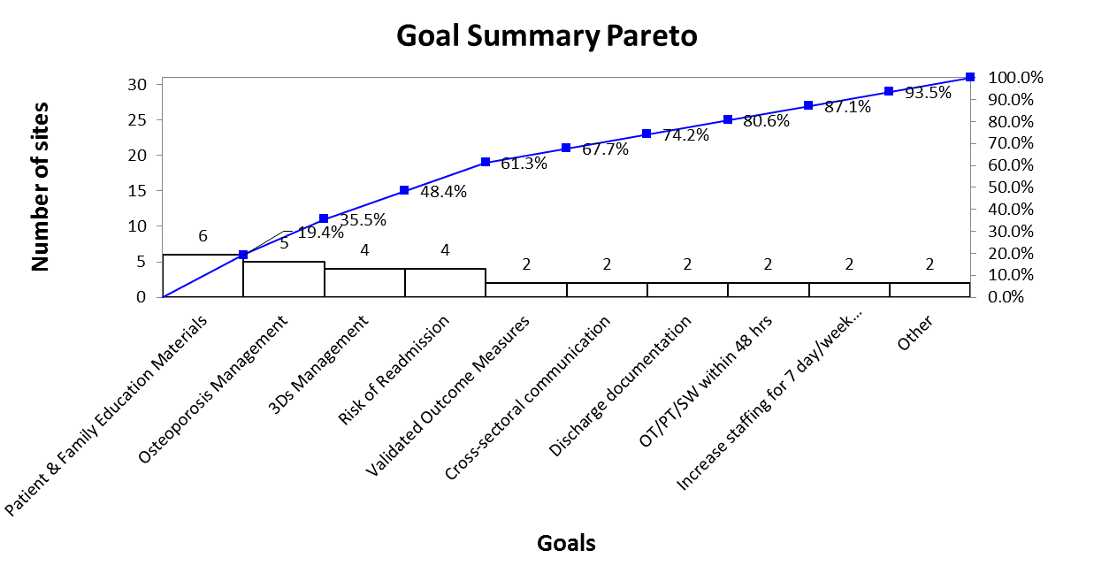
HNHB LHIN Hip Fracture Bedded

Slide 20
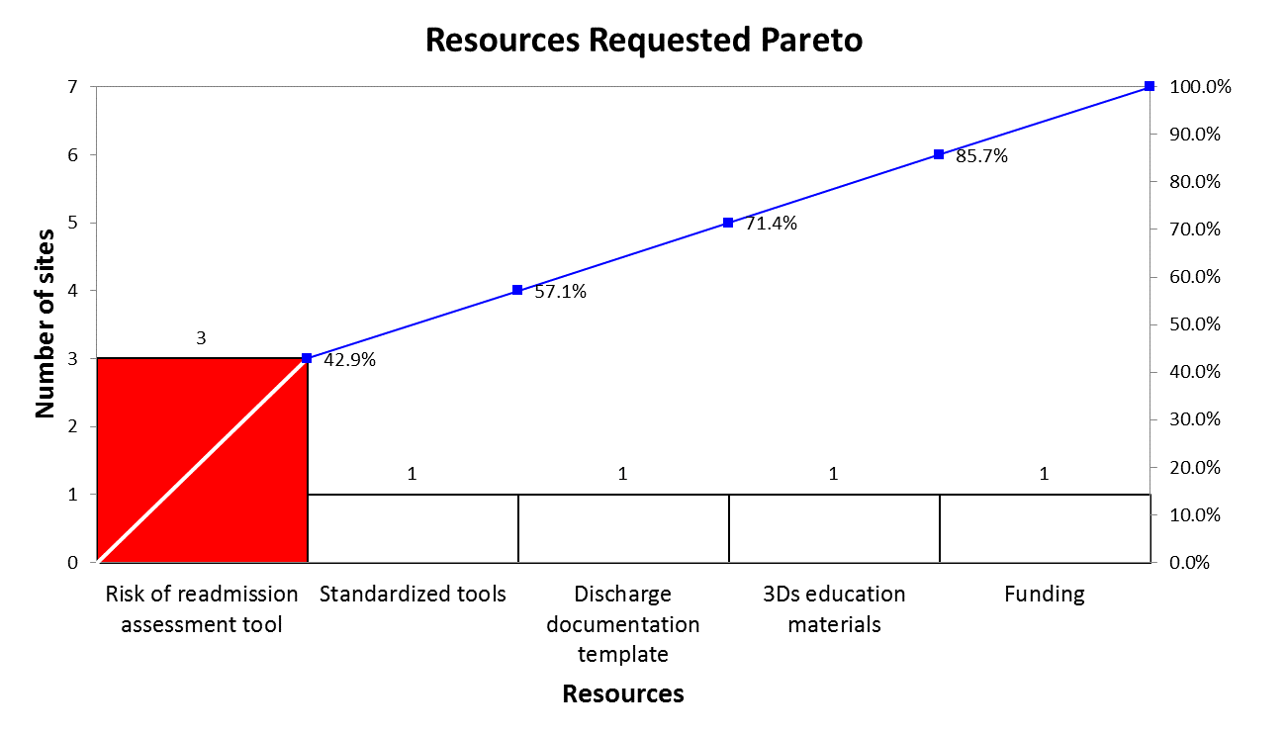
HNHB LHIN Hip Fracture Bedded

Slide 21
Hip Fracture Bedded: HNHB LHIN Pareto Analysis Summary
Goal Summary Pareto
None of the goals contributed to >20% of the cumulative total
The vital few goals that emerged were: Patient & Family Materials, Osteoporosis and 3Ds Management and Risk of Readmission (61.3% of cumulative total)
Resources Pareto
The highest resource requested was Risk of Readmission assessment tool (42.9% of the cumulative total)

Slide 22
Hip Fracture Bedded: Provincial Strengths
Nursing assessments are completed within 24 hours of admission
Skin and wound assessment is completed, using a standardized tool (e.g., Braden Scale); Preventative strategies are identified and implemented
Range of Motion (ROM)/Strengthening/Balancing exercise programs, specific to patients with hip fracture, are provided

Slide 23
Hip Fracture Bedded: HNHB LHIN Strengths
Nursing assessments are completed within 24 hours of admission. Skin and wound assessment is completed, using a standardized tool. Preventative strategies are identified and implemented. Falls risk assessment on admission. Assessments are completed to determine behavioural, cognitive, and functional status.
Rehab goals are established and documented with patient and family.
Dietary intake is monitored and dietary consults are initiated when warranted
Multifactorial, individualized falls prevention strategies are utilized
Treatment including range of motion/strengthening and balance exercise programs and mobility, gait and stairs training
Referrals to home care and/or outpatient providers are made as soon as needs are identified

Slide 24
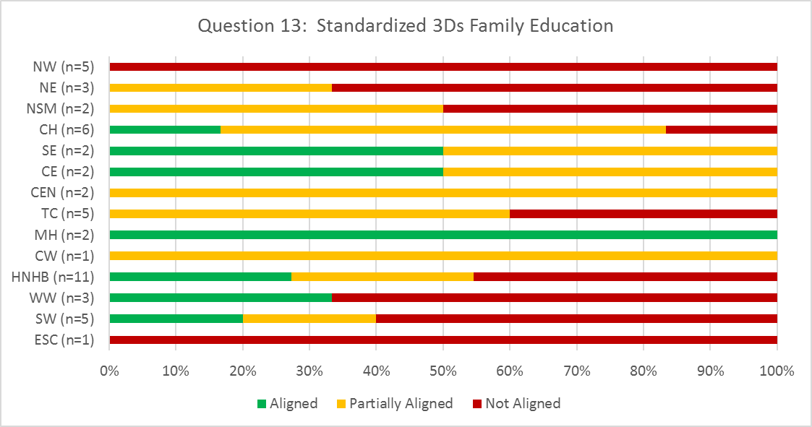
Hip Fracture Bedded: Provincial Opportunities
Screening/Assessment and Prevention/Management of Delirium Dementia and Depression
Provide family with standardized education material on delirium, depression and dementia

Slide 25
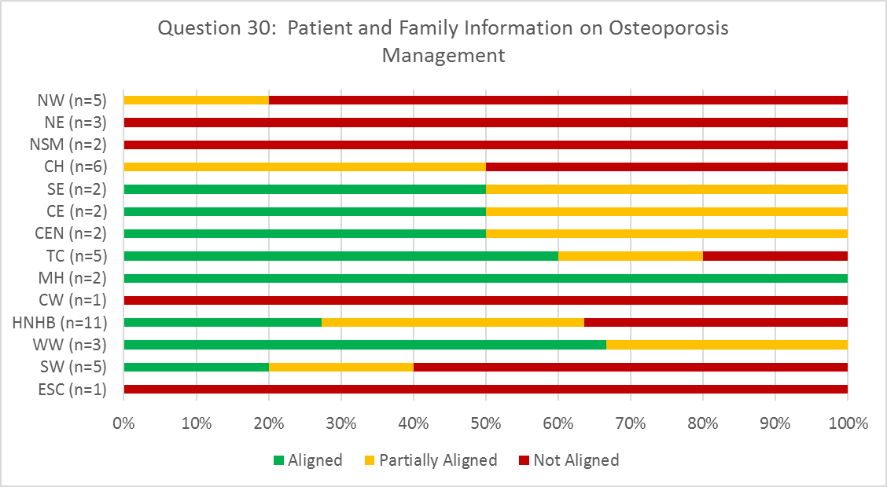
Hip Fracture Bedded: Provincial Opportunities
Patient & Family Education
Patients and families are provided with information regarding osteoporosis management

Slide 26
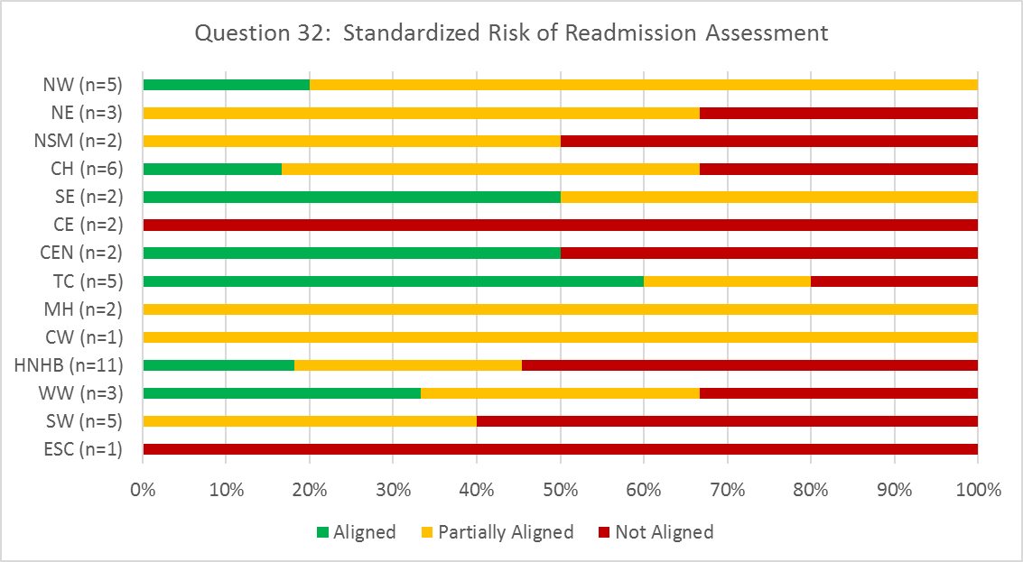
Hip Fracture Bedded: Provincial Opportunities
Transition Planning & Care
Patients' risk of readmission is assessed, using a standardized tool; care and discharge plans are revised required

Slide 27
Hip Fracture Bedded: HNHB LHIN Opportunities
Least aligned best practices
Provide family with standardized education material on delirium, depression and dementia
Patients receive muscle strengthening, balance and posture exercises for Osteoporosis management, as per BONEFIT principles. Patient/Family are provided with Osteoporosis education materials education
Patients and families are provided with information regarding osteoporosis management
Patients' risk of readmission is assessed, using a standardized tool; care and discharge plans are revised required

Slide 28
Hip Fracture Bedded: Best Practice Implementation Strategies
Addressing Provincial Opportunities for Improvement: High Performer Strategies
Co-locate hip fracture patients on 1 unit with a dedicated, interdisciplinary team²
Unique interdisciplinary team members:
Professional Practice Clinician dedicated to Safe Elder Care practices²
Early access to Geriatrician¹
Internal Medicine Reviews¹
Osteoporosis Canada Fracture Prevention Coordinator¹
Surgeon Best Practice Champions¹
Geriatric Hip Fracture Pre and Post-op Order Sets²
Automatic orders for delirium prevention
Care path for delirium includes no night sedation, non-pharmacological sleep protocol, re-orientation
Healthy Bone Treatment
Pharmacy assessment within 48 hours
¹Grand River Hospital
²Halton Healthcare

Slide 29
Hip Fracture Bedded: Best Practice Implementation Strategies (continued)
HELP Program (Hospital Elder Life Program) – (delirium prevention) a multicomponent intervention strategy utilizing a targeted interdisciplinary geriatric assessment and an innovative volunteer model with a structured curriculum, including daily orientation, early mobilization, feeding assistance, therapeutic activities, non-pharmacological sleep protocol and hearing/vision adaptations www.hospitalelderlifeprogram.org ^{1, 2}
Music & Memory Program – (dementia care) taps deep emotional recall which improves relationship building, eases transitions, avoids challenging behaviours and saves time. www.musicandmemory.org²
Staff training in Gentle Persuasive Approach (dementia care) ²
¹Grand River Hospital
²Halton Healthcare

Slide 30
Hip Fracture Bedded: Best Practice Implementation Strategies (continued)
Therapists are BONEFIT certified (osteoporosis management)²
Patient & Family Advisors assist with the development of all patient materials and videos²
Patient entertainment arms have research modules for patients and families to search medical information. For example, diagnoses and medications. ²
Transfer of accountability provided to next health care provider and linkages to community resources²
Therapy coverage during off hours. For example, changing a physiotherapist’s work day to 1400-2200 to provide evening coverage and PT/OT weekend coverage¹
¹Grand River Hospital
²Halton Healthcare

Slide 31
Hip Fracture Ambulatory: Provincial Priorities for Improvement
LHIN | ESC (n=1) | SW (n=2) |  | HNHB (n=2) |  | CW n=1 | MH n=1 | TC (n=5) |  |  |  |  | CE n=1 | CH (n=3) |  |  | NE n=1 | NW (n=4) |  |  |  | Multi n=1
Assessment | Well Aligned | Well Aligned | Priority for Improvement | Well Aligned | Well Aligned | Well Aligned | Well Aligned | Well Aligned | Well Aligned | Well Aligned | Well Aligned | Well Aligned | Well Aligned | Well Aligned | Well Aligned | Well Aligned | Well Aligned | Well Aligned | Well Aligned | Well Aligned | Well Aligned | Well Aligned
Delirium/ Dementia/ Depression | Priority for Improvement | Well Aligned | Priority for Improvement | Well Aligned | Well Aligned | Priority for Improvement | Well Aligned | Priority for Improvement | Priority for Improvement | Priority for Improvement | Priority for Improvement | Well Aligned | Priority for Improvement | Well Aligned | Priority for Improvement | Well Aligned | Priority for Improvement | Priority for Improvement | Priority for Improvement | Priority for Improvement | Well Aligned | Well Aligned
Interprofessional Intervention | Priority for Improvement | Well Aligned | Priority for Improvement | Well Aligned | Well Aligned | Priority for Improvement | Well Aligned | Well Aligned | Priority for Improvement | Priority for Improvement | Priority for Improvement | Well Aligned | Priority for Improvement | Well Aligned | Priority for Improvement | Well Aligned | Well Aligned | Priority for Improvement | Well Aligned | Priority for Improvement | Well Aligned | Well Aligned
Patient & Family Education | Well Aligned | Well Aligned | Priority for Improvement | Well Aligned | Well Aligned | Well Aligned | Well Aligned | Well Aligned | Well Aligned | Well Aligned | Well Aligned | Well Aligned | Well Aligned | Well Aligned | Well Aligned | Well Aligned | Well Aligned | Well Aligned | Well Aligned | Well Aligned | Well Aligned | Well Aligned
Transition Planning | Well Aligned | Well Aligned | Well Aligned | Well Aligned | Well Aligned | Well Aligned | Well Aligned | Well Aligned | Well Aligned | Well Aligned | Well Aligned | Well Aligned | Well Aligned | Well Aligned | Well Aligned | Well Aligned | Well Aligned | Well Aligned | Well Aligned | Well Aligned | Well Aligned | Well Aligned
*MultiLHIN organization providing services in HNHB LHIN included in analysis

Slide 32
Hip Fracture Ambulatory: Provincial Goals & Resources Analysis
Goal Summary
Patient and Family Education Materials and Osteoporosis Management were the most cited goals by organizations (57.1% of the cumulative total)
Resources
The highest resources requested were Out-patient Standardized Assessment Tools, 3Ds and Osteoporosis Resources and Education (83.33% of the cumulative total)
See Appendix A for Pareto Diagrams

Slide 33
Hip Fracture Ambulatory: HNHB LHIN Goals and Resources Requested
Short Term Goals
BONEFIT and Osteoporosis Management
Awareness of community fall prevention programs
Patient & family education materials
Cognitive assessment
Mid-Range Goals
General education program for hip fracture population
Osteoporosis patient & family education
Delirium/Dementia/Depression management
Long Term Goals
Funding to increase services
Referral management with Home & Community Care
Resources
Standardized patient & family education materials
Risk of readmission screening
Delirium/Dementia/Depression education and tools

Slide 34
Hip Fracture Ambulatory: Provincial Strengths
Balance and strength training, and progressive strengthening exercise program, are provided
Patients/caregivers are engaged in regular communication to review care and treatment programs and discharge plans
Clients are discharged from outpatient rehab based on the achievement of goals and evidence from standardized outcome measures

Slide 35
Hip Fracture Ambulatory: HNHB LHIN Strengths
A function assessment is completed, using standardized outcomes measures
Suspicion of delirium is recognized and treated as a medical emergency; urgent intervention is provided.
Clinicians contribute a comprehensive clinical assessment of cognition, based on standardized assessments, ongoing observations, and expressed concerns from the patient, family, and interdisciplinary team. Assessment findings trigger referral to geriatrician, geriatric psychiatry, or social worker, as appropriate
If depression is suspected, a member of the clinical team completes a valid and reliable assessment for depression
Pain is assessed using a validated pain scale. Multi-modal pain management strategies are utilized.

Slide 36
Hip Fracture Ambulatory: HNHB LHIN Strengths (continued)
Patients with pressure ulcers or at risk for developing pressure ulcers receive an individualized plan of care
Falls risk is assessed and multifactorial, individualized falls prevention strategies are utilized
Interventions to improve independence and balance and strength training exercise programs and safe outdoor mobility
Driving: educate clients and family that changes in medication/cognition/decrease function increase risk of MVAs.
Patient/caregiver communication and education to review care and treatment programs
Clients discharge based on achievement of goals. Face to face discharge conversations are held and client and family are aware of referrals for community services/consultations/medical follow-up.

Slide 37
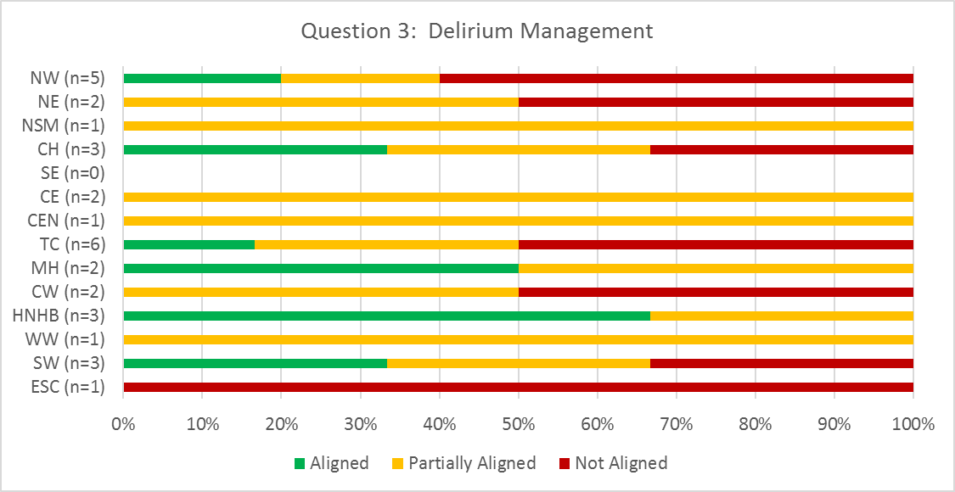
Hip Fracture Ambulatory: Provincial Opportunities
Screening/Assessment and Prevention/Management of Delirium Dementia and Depression
Existing delirium is monitored and management strategies intervention/management strategies are utilized. (These strategies should include consideration of the following precipitating factors for delirium: immobility, malnutrition, more than three medications, use of bladder catheter, and any iatrogenic events during hospitalization).

Slide 38
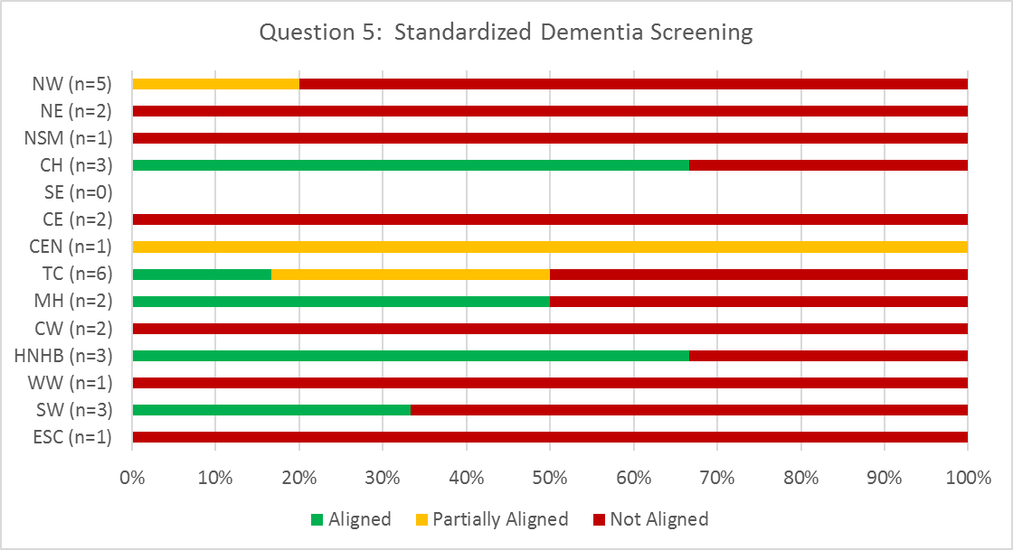
Hip Fracture Ambulatory: Provincial Opportunities
Screening/Assessment and Prevention/Management of Delirium Dementia and Depression
Patients are screen for dementia using, a standardized screening assessment tool (e.g., Mini-Cog or MMSE or MOCA) in consideration of the patient’s pre-morbid cognitive function.

Slide 39
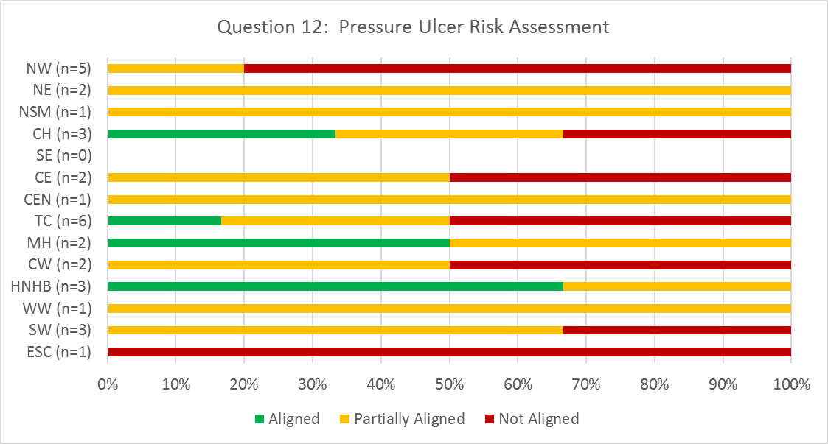
Hip Fracture Ambulatory: Provincial Opportunities
Interprofessional Interventions/Treatment
Patients' risk for pressure ulcer development is determined through multi-disciplinary clinical judgement and the use of a valid reliable risk assessment tool (i.e.., Braden Scale).

Slide 40
Hip Fracture Ambulatory: HNHB LHIN Opportunities
Least aligned best practices
Rehabilitation commences no later than one week following discharge from acute care and last an average of 8 weeks, depending on clinical needs
As all individuals with a fragility fracture of the hip should be considered as high risk for osteoporotic fractures; patients receive muscle strengthening, balance and posture exercises for Osteoporosis management, as per BONEFIT principles. Patient/Family are provided with Osteoporosis education materials education.
Patient education materials have been developed using plain language and are compliant with the Accessibility for Ontarians with Disabilities Act (AODA) requirements for accessibility
Patients and families are provided with information regarding osteoporosis management.

Slide 41
Hip Fracture Ambulatory: Best Practice Implementation Strategies
Addressing Provincial Opportunities for Improvement: High Performer Strategies
Transfer of Accountability from Bedded Sector
Involvement of families and caregivers, including information regarding “what to watch for” for delirium
Staff training in Gentle Persuasive Approach
Motivational Interviewing techniques utilized
Interdisciplinary teams from multiple ambulatory clinics are co-located to allow for team rounding/huddles to develop best strategies for individual patient care
Interdisciplinary teams include PT, OT, SLP, Nursing, Nurse Practitioner, Social Work and Geriatrician
Halton Healthcare

Slide 42
Hip Fracture In-Home: Provincial Priorities for Improvement
LHIN | SW (n=2) |  | WW (n=2) |  | HNHB (n=1) | CW (n=1) | MH (n=1) | TC (n=1) | CE (n=2) |  | CH (n=2) |  | NE (n=1) | NW (n=5) |  |  |  |  | MultiLHIN (n=2)
Assessment | Priority for Improvement | Well Aligned | Well Aligned | Well Aligned | Priority for Improvement | Well Aligned | Well Aligned | Well Aligned | Priority for Improvement | Priority for Improvement | Priority for Improvement | Well Aligned | Priority for Improvement | Well Aligned | Well Aligned | Well Aligned | Well Aligned | Priority for Improvement | Well Aligned | Well Aligned
Delirium/ Dementia/ Depression | Well Aligned | Well Aligned | Well Aligned | Priority for Improvement | Well Aligned | Well Aligned | Well Aligned | Priority for Improvement | Well Aligned | Well Aligned | Priority for Improvement | Well Aligned | Priority for Improvement | Well Aligned | Priority for Improvement | Priority for Improvement | Well Aligned | Priority for Improvement | Well Aligned | Priority for Improvement
Interprofessional Intervention | Well Aligned | Well Aligned | Well Aligned | Well Aligned | Well Aligned | Well Aligned | Well Aligned | Well Aligned | Well Aligned | Well Aligned | Well Aligned | Well Aligned | Well Aligned | Well Aligned | Well Aligned | Well Aligned | Well Aligned | Well Aligned | Well Aligned | Well Aligned
Patient & Family Education | Well Aligned | Well Aligned | Well Aligned | Well Aligned | Well Aligned | Well Aligned | Well Aligned | Well Aligned | Well Aligned | Well Aligned | Well Aligned | Well Aligned | Well Aligned | Well Aligned | Well Aligned | Well Aligned | Well Aligned | Well Aligned | Well Aligned | Well Aligned
Transition Planning | Well Aligned | Well Aligned | Well Aligned | Well Aligned | Well Aligned | Well Aligned | Well Aligned | Well Aligned | Well Aligned | Well Aligned | Well Aligned | Well Aligned | Well Aligned | Well Aligned | Well Aligned | Priority Improvement | Well Aligned | Well Aligned | Well Aligned | Well Aligned
*MultiLHIN organization providing services in HNHB LHIN included in analysis

Slide 43
Hip Fracture In-Home: Provincial Goals & Resources Analysis
Goal Summary
3Ds Management was the most cited goal by organizations (29.2% of the cumulative total)
Resources
The highest resources requested were 3Ds and Osteoporosis Resources and Education (56.3% of the cumulative total)
See Appendix A for Pareto Diagrams

Slide 44
Hip Fracture In-Home: HNHB LHIN Goals and Resources Requested
Short Term Goals
Education resources for osteoporosis and delirium/dementia/depression
BONEFIT certification
Mid-Range Goals
AODA compliant patient and family education materials
Long Term Goals
Build stronger LHIN & stakeholder relationships
Resources
Clinician best practice framework resources
Patient & family education materials
Delirium/Dementia/Depression education and tools

Slide 45
Hip Fracture In-Home: Provincial Strengths
Falls risk is assessed and multifactorial, individualized falls prevention strategies are utilized(e.g., BEEEACH – behavior change, education, equipment, environment, activity, clothing, health management) together with an appropriate exercise program.
Intervention includes the provision of equipment/aids and strategies for improving independence with ADLs; clients are encouraged and supported to be as independence as possible
Interventions include muscle and bone strengthening exercises
Patients/caregivers are engaged in regular communication to review care and treatment programs and discharge plans
Patients and their families received education regarding their falls risk status, including patient/family role in safety and falls prevention.
Notes:
All aligned

Slide 46
Hip Fracture In-Home: HNHB LHIN Strengths
Delirium/Dementia/Depression screening/assessment and prevention/management
Patients receive interprofessional rehabilitation, in accordance with the principles of geriatric care
Pain is assessed using a validated pain scale. Multi-modal pain management strategies are utilized.
Patients with pressure ulcers or at risk for developing pressure ulcers receive an individualized plan of care, based on identified intrinsic and extrinsic risk factors and those identified by a risk assessment tool
Falls risk is assessed and multifactorial, individualized falls prevention strategies are utilized together with an appropriate exercise program

Slide 47
Hip Fracture In-Home: HNHB LHIN Strengths (continued)
Validated outcomes measures are utilized (e.g., TUG/Barthel) on admission and discharge to track progress in function and mobility
Interventions to promote independence, muscle and bone strengthening, driving and safe outdoor mobility are provided
Patients/caregivers are engaged in regular communication to review care and treatment programs, discharge plans and falls risk status
Principles of healthy lifestyles are incorporated into the rehab program. Prior to discharge, patients are linked to appropriate community supports and/or exercise programs. Patients have the date and time of their next health care provider appointment.

Slide 48
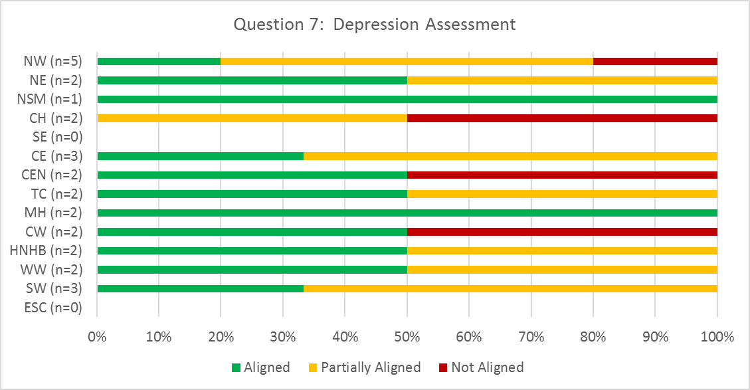
Hip Fracture In-Home: Provincial Opportunities
Screening/Assessment and Prevention/Management of Delirium Dementia and Depression
If depression is suspected, a member of the clinical team completes a valid and reliable assessment for depression (e.g., Geriatric Depression Scale or Cornell Depression Scale for those with dementia)

Slide 49
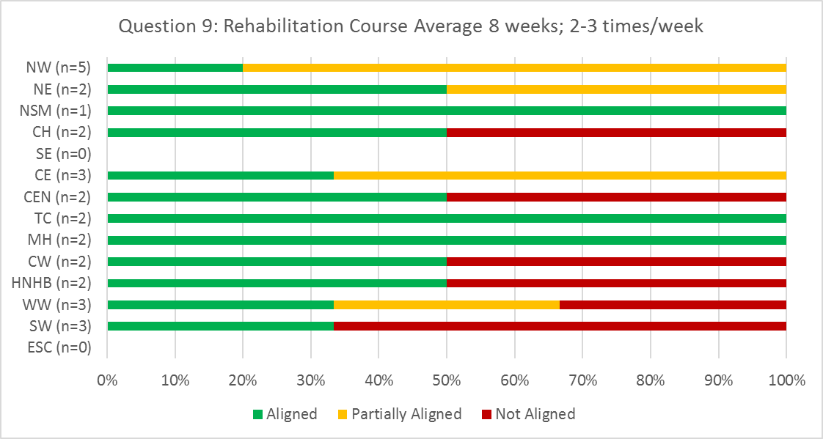
Hip Fracture In-Home: Provincial Opportunities
Interprofessional Interventions/Treatment
Rehabilitation course lasts an average of 8 weeks; 2-3 times per week, depending on clinical needs and tolerance

Slide 50
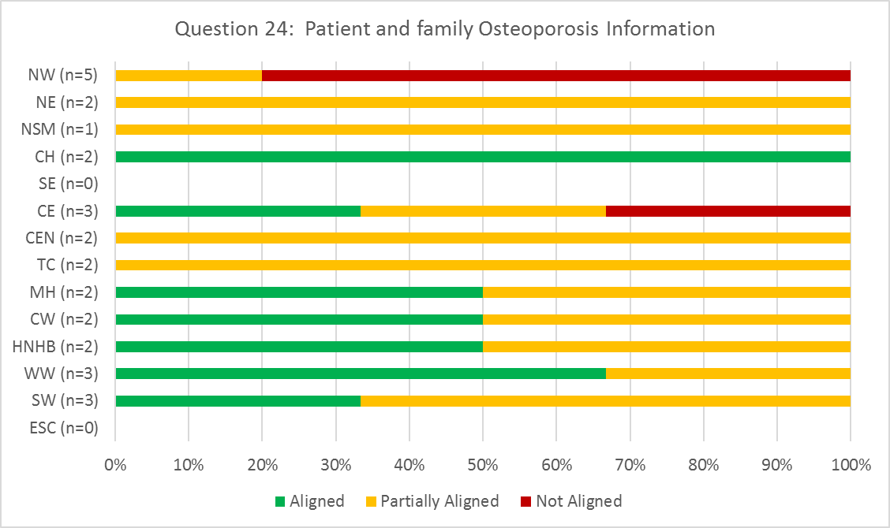
Hip Fracture In-Home: Provincial Opportunities
Patient & Family Education
Patients and families are provided with information regarding osteoporosis management.

Slide 51
Hip Fracture In-Home: HNHB LHIN Opportunities
Least aligned best practices
Assessment is completed within 48 hours of discharge from acute care
Rehabilitation course lasts an average of 8 weeks; 2-3 times per week, depending on clinical needs and tolerance

Slide 52
Hip Fracture In-Home: Best Practice Implementation Strategies
Addressing Provincial Opportunities for Improvement: High Performer Strategies
Delirium/Dementia/Depression strategies:
Embedded in therapy initial assessment form
3Ds Standardized Outcome Measures: SIGECAPS, Geriatric Depression Scale, Mini-Cog, MoCA, Confusion Assessment Method (CAM)
Rehabilitation treatment sessions average 8 weeks 2-3 visits/week using a PT-PTA care model
BONEFIT certified therapists act as Osteoporosis Practice Champions
Team meetings are focused on reflective clinical practice, peer to peer collaboration, case reviews and coaching to implement best practice
SE Health – Mississauga-Halton LHIN

Slide 53
Hip Fracture LTC: Provincial Priorities for Improvement
LHIN | SW (n=2) |  | WW (n=3) |  |  | HNHB (n=8) |  |  |  |  |  |  |  | MH n=1 | TC (n=3) |  |  | SE n=1 | CH n=1 | NW (n=3)
Assessment | Well Aligned | Priority for Improvement | Well Aligned | Priority for Improvement | Well Aligned | Well Aligned | Well Aligned | Well Aligned | Priority for Improvement | Well Aligned | Well Aligned | Priority for Improvement | Priority for Improvement | Priority for Improvement | Well Aligned | Well Aligned | Well Aligned | Well Aligned | Well Aligned | Well Aligned | Priority for Improvement | Well Aligned
Delirium/ Dementia/ Depression | Well Aligned | Well Aligned | Well Aligned | Well Aligned | Well Aligned | Well Aligned | Well Aligned | Well Aligned | Well Aligned | Well Aligned | Well Aligned | Well Aligned | Well Aligned | Well Aligned | Well Aligned | Well Aligned | Well Aligned | Well Aligned | Well Aligned | Well Aligned | Priority for Improvement | Well Aligned
Interprofessional Intervention | Well Aligned | Well Aligned | Well Aligned | Well Aligned | Well Aligned | Well Aligned | Well Aligned | Well Aligned | Well Aligned | Well Aligned | Well Aligned | Well Aligned | Well Aligned | Well Aligned | Well Aligned | Well Aligned | Well Aligned | Well Aligned | Well Aligned | Priority Improvement | Well Aligned | Well Aligned
Patient & Family Education | Well Aligned | Well Aligned | Well Aligned | Well Aligned | Well Aligned | Well Aligned | Well Aligned | Well Aligned | Well Aligned | Well Aligned | Well Aligned | Well Aligned | Well Aligned | Well Aligned | Well Aligned | Well Aligned | Well Aligned | Well Aligned | Well Aligned | Well Aligned | Well Aligned | Well Aligned
Transition Planning | Well Aligned | Well Aligned | Well Aligned | Well Aligned | Well Aligned | Well Aligned | Well Aligned | Well Aligned | Well Aligned | Well Aligned | Well Aligned | Well Aligned | Well Aligned | Well Aligned | Well Aligned | Well Aligned | Well Aligned | Well Aligned | Well Aligned | Priority for Improvement | Well Aligned | Well Aligned

Slide 54
Hip Fracture LTC: Provincial Goals & Resources Analysis
Goal Summary
None of the goals contributed to >20% of the cumulative total
The vital few goals that emerged were: Fall Risk Management, Frailty Assessment Tool and Osteoporosis Management (43.1% of cumulative total)
Resources
The highest resources requested were Frailty Assessment & Intervention Strategies and Osteoporosis Resources (52.7% of the cumulative total)
See Appendix A for Pareto Diagrams

Slide 55
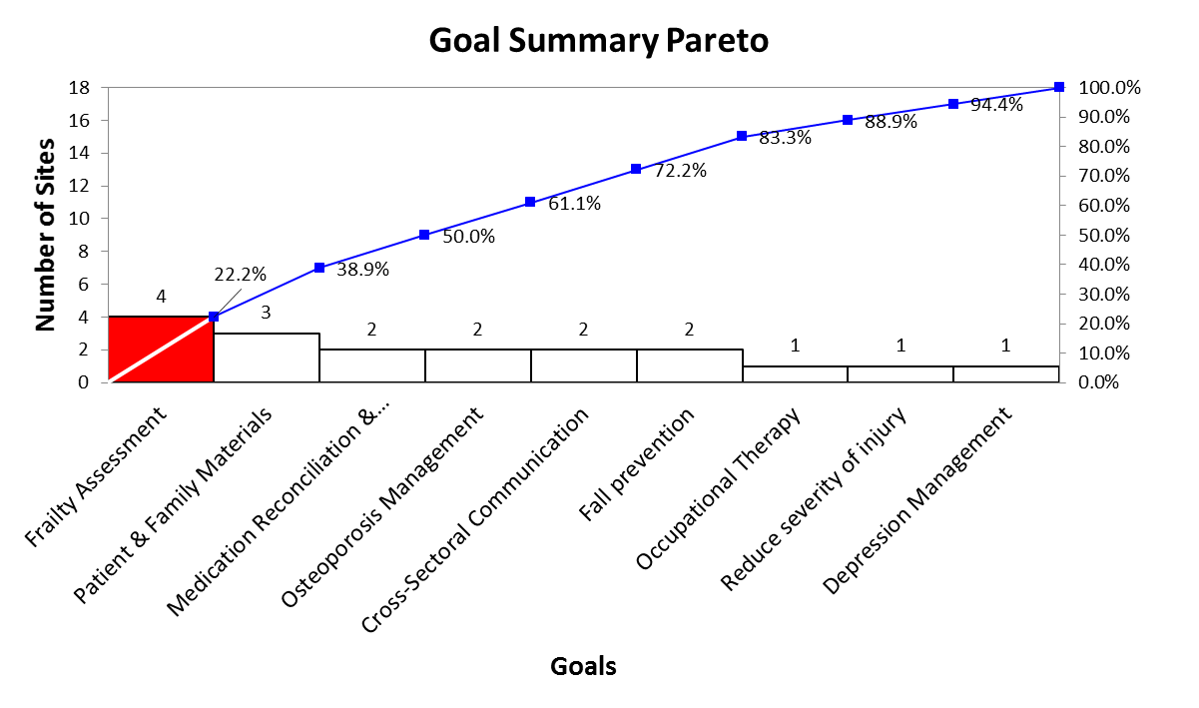
HNHB LHIN Hip Fracture LTC

Slide 56
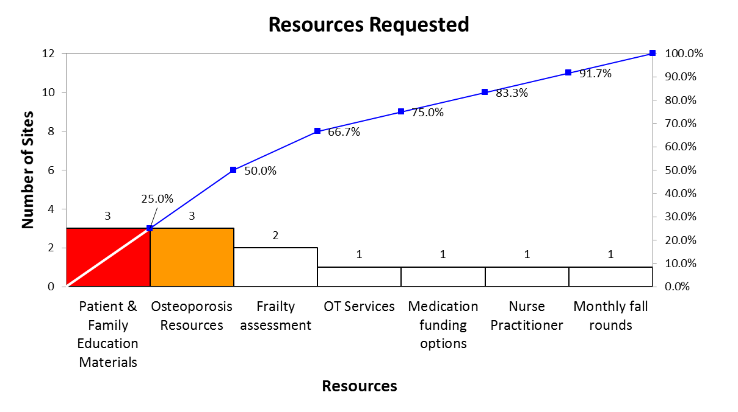
HNHB LHIN Hip Fracture LTC

Slide 57
Hip Fracture LTC: HNHB LHIN Pareto Analysis Summary
Goal Summary Pareto
Frailty Assessment was the most cited goal (25% of cumulative total)
Resources Pareto
The highest resources requested were Patient & Family Education Materials and Osteoporosis Management (50% of the cumulative total)

Slide 58
Hip Fracture LTC: Provincial Strengths
Those with poor mobility are provided with physical activities to improve balance and prevent falls
Residents and families are regularly engaged in ongoing communication to review care and the treatment program
Resident and family concerns are identified and addressed

Slide 59
Hip Fracture LTC: HNHB LHIN Strengths
A function assessment is completed, using standardized outcomes measures
As appropriate, patients are screen for dementia using, a standardized screening assessment tool
If depression is suspected, a member of the clinical team completes a valid and reliable assessment for depression
Interprofessional rehabilitation, in accordance with the principles of geriatric care
Pain is assessed using a validated pain scale. Multi-modal pain management strategies are utilized.

Slide 60
Hip Fracture LTC: HNHB LHIN Strengths (continued)
Patients' risk for pressure ulcer development is determined through multi-disciplinary clinical judgement and the use of a valid reliable risk assessment tool. Individualized plan of care is developed.
Patients receive muscle strengthening, balance and posture exercises for Osteoporosis management, as per BONEFIT principles. Patient/Family are provided with Osteoporosis education materials education
Falls risk is assessed and multifactorial, individualized falls prevention strategies are together with an appropriate exercise program.
Intervention includes progression of functional abilities, assistive devices and physical activities to improve balance and prevent falls
Ongoing communication with residents and families, including concerns identified and addressed

Slide 61
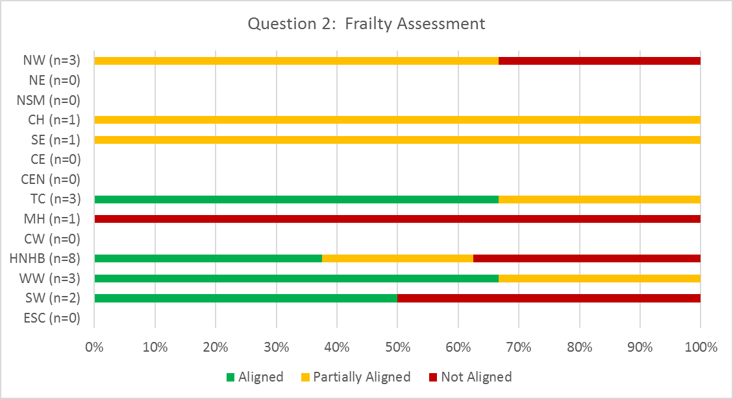
Hip Fracture LTC: Provincial Opportunities
Assessment/Monitoring
Frailty assessment is completed to inform interventions to minimize frailty

Slide 62
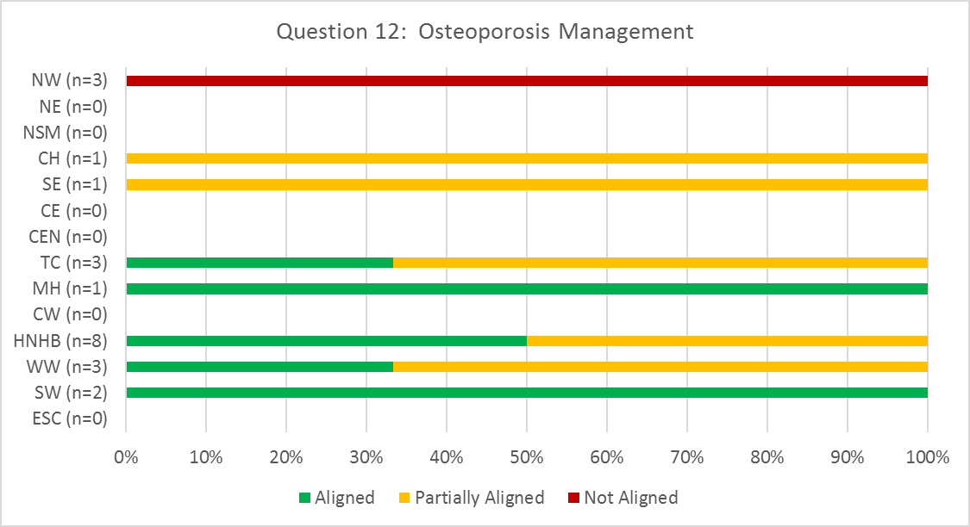
Hip Fracture LTC: Provincial Opportunities
Interprofessional Interventions/Treatment
As all individuals with a fragility fracture of the hip should be considered as high risk for osteoporotic fractures; patients receive muscle strengthening, balance and posture exercises for Osteoporosis management, as per BONEFIT principles. Patient/Family are provided with Osteoporosis education materials education (available at osteoporosis.ca)

Slide 63
Hip Fracture LTC: HNHB LHIN Opportunities
Least aligned best practices
Frailty assessment is completed to inform interventions to minimize frailty
As all individuals with a fragility fracture of the hip should be considered as high risk for osteoporotic fractures; patients receive muscle strengthening, balance and posture exercises for Osteoporosis management, as per BONEFIT principles. Patient/Family are provided with Osteoporosis education

Slide 64
TJR Pre-operative Care: Provincial Priorities for Improvement
LHIN | ESC n=1 | SW (n=3) |  |  | WW (n=2) |  | HNHB (n=5) |  |  |  |  | CW | MH (n=2) |  | TC n=1 | C n=1 | CE (n=2) |  | SE (n=2) |  | CH (n=4) |  |  |  | NE (n=2) |  | NW (n=5)
Screening | Priority for Improvement | Well Aligned | Well Aligned | Well Aligned | Priority for Improvement | Well Aligned | Priority for Improvement | Priority for Improvement | Well Aligned | Priority for Improvement | Priority for Improvement | Priority for Improvement | Priority for Improvement | Well Aligned | Well Aligned | Priority for Improvement | Priority for Improvement | Well Aligned | Well Aligned | Priority for Improvement | Well Aligned | Priority for Improvement | Priority for Improvement | Well Aligned | Priority for Improvement | Priority for Improvement | Well Aligned | Well Aligned | Well Aligned | Well Aligned | Well Aligned
Assessment | Priority for Improvement | Priority for Improvement | Well Aligned | Well Aligned | Well Aligned | Well Aligned | Well Aligned | Well Aligned | Well Aligned | Well Aligned | Well Aligned | Priority for Improvement | Well Aligned | Well Aligned | Well Aligned | Priority for Improvement | Priority for Improvement | Well Aligned | Well Aligned | Priority for Improvement | Well Aligned | Well Aligned | Well Aligned | Well Aligned | Priority for Improvement | Well Aligned | Well Aligned | Well Aligned | Well Aligned | Well Aligned | Well Aligned
Treatment | Well Aligned | Priority for Improvement | Well Aligned | Well Aligned | Well Aligned | Well Aligned | Well Aligned | Well Aligned | Well Aligned | Well Aligned | Priority for Improvement | Priority for Improvement | Well Aligned | Well Aligned | Well Aligned | Well Aligned | Priority for Improvement | Well Aligned | Well Aligned | Priority for Improvement | Well Aligned | Well Aligned | Well Aligned | Well Aligned | Priority for Improvement | Well Aligned | Well Aligned | Well Aligned | Well Aligned | Well Aligned | Well Aligned
Patient & Family Education | Well Aligned | Well Aligned | Well Aligned | Well Aligned | Well Aligned | Well Aligned | Well Aligned | Well Aligned | Well Aligned | Well Aligned | Well Aligned | Priority for Improvement | Well Aligned | Well Aligned | Well Aligned | Priority for Improvement | Well Aligned | Well Aligned | Well Aligned | Well Aligned | Well Aligned | Well Aligned | Well Aligned | Well Aligned | Well Aligned | Well Aligned | Well Aligned | Well Aligned | Well Aligned | Well Aligned | Well Aligned
Transition Planning | Well Aligned | Priority for Improvement | Well Aligned | Well Aligned | Well Aligned | Well Aligned | Priority for Improvement | Well Aligned | Well Aligned | Well Aligned | Priority for Improvement | Priority for Improvement | Well Aligned | Well Aligned | Well Aligned | Priority for Improvement | Well Aligned | Well Aligned | Well Aligned | Priority for Improvement | Well Aligned | Well Aligned | Well Aligned | Well Aligned | Well Aligned | Priority for Improvement | Priority for Improvement | Priority for Improvement | Priority for Improvement | Priority for Improvement | Well Aligned

Slide 65
TJR Pre-op: Provincial Goals & Resources Analysis
Goal Summary
The most cited goal was Co-ordination with the Entire Pre and Post-op Team (23.2% of the cumulative total)
Resources
The highest resource requested was Increased Staffing (35.7% of the cumulative total)
See Appendix A for Pareto Diagrams

Slide 66
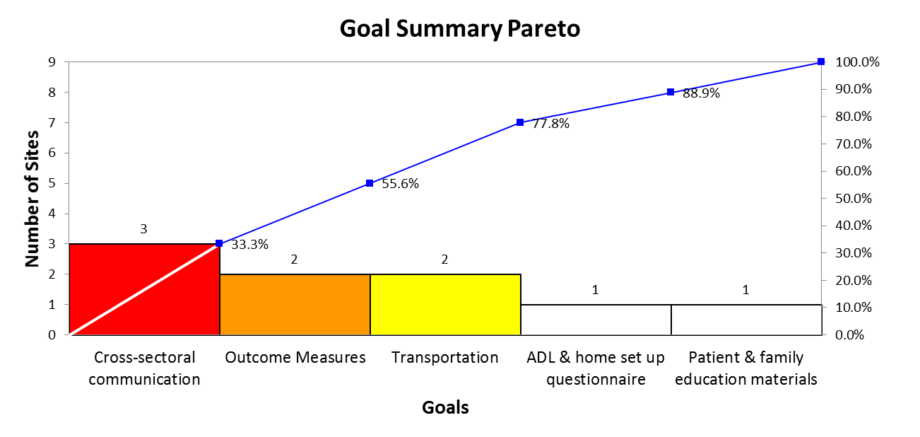
HNHB LHIN TJR Pre-op

Slide 67
TJR Pre-op: HNHB LHIN Goals & Resources Requested
Goal Summary Pareto
The most cited goals were cross-sectoral communication, outcome measures and transportation (77.8% of the cumulative total)
Resources Requested:
Social support outcome measures
Standardized assessment tools to determine post-surgical destination

Slide 68
TJR Pre-Op: Provincial Strengths
Patients are provided with information regarding equipment, assistive devices, gait aid, and home modification requirements prior to surgery
A standardized and consolidated patient information package is to patients/caregivers
Patient education includes the information on the following: expected length of stay; precautions and joint protection; energy conservation and pain management techniques; information on assistive devices; planning for the procurement of equipment, preparing the home, and arranging for help with meal planning/other iADLS; exercise, functional activities, ADLs

Slide 69
TJR Pre-Op: HNHB LHIN Strengths
Patients' functional ability is assessed to determine level of disability and urgency rating.
Physiotherapy and/or Occupational Therapy Assessment(s) completed to determine equipment needs post-surgery
Patients are provided with information regarding equipment, assistive devices, gait aid, and home modification requirements prior to surgery
Patients/caregivers are provided a standardized consolidated patient information package that is AODA compliant and includes expected length of stay; precautions and joint protection; energy conservation and pain management techniques; information on assistive devices; planning for the procurement of equipment, preparing the home, and arranging for help with meal planning/other IADLs; exercise, functional activities, ADLs
Patients are provided with contact information for patients in the event that they have any follow-up questions

Slide 70
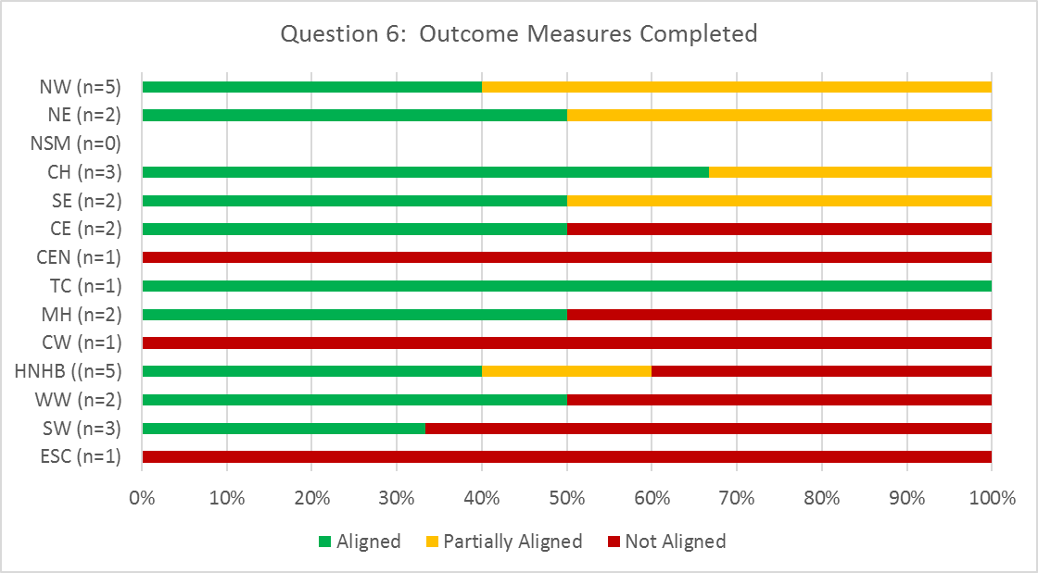
TJR Pre-Op: Provincial Opportunities
Assessment
Pre-operative outcome measure(s) are completed, to establish a benchmark for patient progress and achievement of functional outcomes [examples: Western Ontario and McMaster Universities Osteoarthritis Index WOMAC; Lower Extremity Functional Scale (LEFS); Patient Specific Functional Scale (PSFS); Timed Up and Go (TUG)]

Slide 71
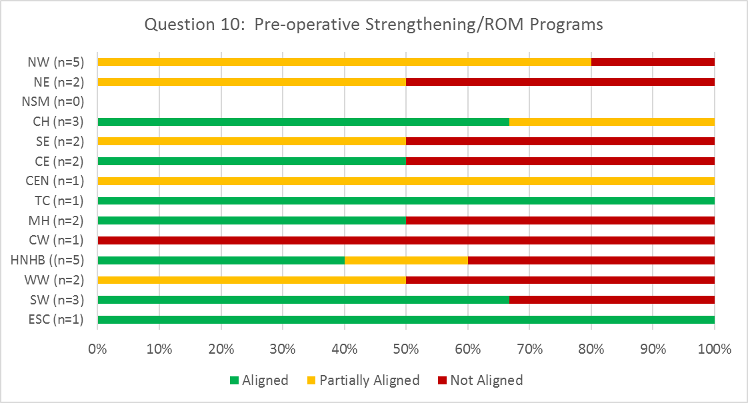
TJR Pre-Op: Provincial Opportunities
Treatment
Patients are referred to preoperative strengthening/range of motion programs, when appropriate (including NEMEX and GLAD)

Slide 72
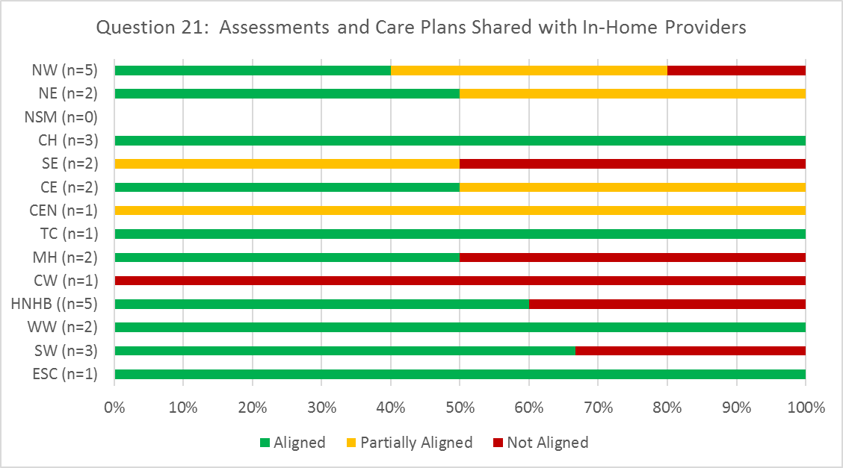
TJR Pre-Op: Provincial Opportunities
Transition Planning
For patients who are expected to receive their rehabilitative care in-home, due to risk or complexity the interdisciplinary assessment results and care plan is shared with the in-home provider.

Slide 73
TJR Pre-Op: HNHB LHIN Opportunities
Least aligned best practices
Patients are screened pre-operatively in order to predict post-operative discharge needs, and to identify whether the patient would benefit from a preoperative in-home OT or PT visit
Assessments are completed to confirm post-surgery discharge destination o (i.e., home care, outpatient rehab, bedded rehab)
Pre-operative outcome measure(s) are completed, to establish a benchmark for patient progress and achievement of functional outcomes
Patients are referred to preoperative strengthening/range of motion programs, when appropriate

Slide 74
TJR Pre-operative Care: Best Practice Implementation Strategies
Addressing Provincial Opportunities for Improvement: High Performer Strategies
Prehab Program
Mandatory attendance (utilizing bundled funding)¹
In person prehab classes or prehab video 2-3 months prior to surgery^{1, 2}
Early screening for transition planning^{1, 2, 3, 4}
High risk patients are immediately engaged by Social Work, Discharge Planning and/or Inpatient Rehabilitation Manager^{1, 2}
Individual meetings with PT, OT, Fracture Clinic Nurse to assist with planning for equipment, care concerns and special needs^{1, 2, 3, 4}
Special needs communicated with managers on inpatient, OR, PACU, Day Surgery and Pre-op Clinic³
¹ Halton Healthcare
²Peterborough Regional Health Centre
³St. Joseph’s Healthcare Hamilton
⁴Sunnybrook Health Sciences Centre

Slide 75
TJR Pre-operative Care: Best Practice Implementation Strategies (continued)
Advanced Practice Physiotherapist/Intake Clinic screens surgical versus conservative treatment^{2, 3, 4}
Those exploring conservative measures are offered GLA:D program and other osteoarthritis best practice treatments⁴
Outcome measures: Sit-stand chair test, Timed Up & Go, 40 Metre Walk Test, LEFS⁴
Mobile app provides pre-op education, reminders for pre-op preparation and post-op self-management^{1, 4}
Families are included to assist with the use of the app (with the senior population)
Example app: CoHealth
¹ Halton Healthcare
²Peterborough Regional Health Centre
³St. Joseph’s Healthcare Hamilton
⁴Sunnybrook Health Sciences Centre

Slide 76
TJR Bedded: Provincial Priorities for Improvement
LHIN | ESC (n=2) |  | SW (n-5) |  |  |  |  | WW (n=3) |  |  | HNHB (n=7) |  |  |  |  |  |  | CW (1) | MH (n=2) |  | TC (n=2) |  | C (1) | CE (n=2) |  | SE (n=2) |  | CH (n=5) |  |  |  |  | NSM (1) | NE (n=2) |  | NW (n=4)
Assessment | Well Aligned | Well Aligned | Well Aligned | Well Aligned | Well Aligned | Well Aligned | Well Aligned | Well Aligned | Well Aligned | Well Aligned | Well Aligned | Well Aligned | Well Aligned | Well Aligned | Well Aligned | Well Aligned | Well Aligned | Well Aligned | Well Aligned | Well Aligned | Well Aligned | Well Aligned | Well Aligned | Well Aligned | Well Aligned | Well Aligned | Well Aligned | Well Aligned | Well Aligned | Well Aligned | Well Aligned | Well Aligned | Well Aligned | Well Aligned | Well Aligned | Well Aligned | Well Aligned | Well Aligned | Well Aligned
Treatment | Well Aligned | Well Aligned | Well Aligned | Well Aligned | Priority for Improvement | Well Aligned | Well Aligned | Well Aligned | Well Aligned | Well Aligned | Well Aligned | Well Aligned | Well Aligned | Well Aligned | Well Aligned | Well Aligned | Well Aligned | Well Aligned | Well Aligned | Well Aligned | Well Aligned | Well Aligned | Well Aligned | Well Aligned | Well Aligned | Well Aligned | Well Aligned | Well Aligned | Well Aligned | Well Aligned | Well Aligned | Well Aligned | Well Aligned | Well Aligned | Well Aligned | Well Aligned | Well Aligned | Well Aligned | Well Aligned
Patient & Family Education | Well Aligned | Well Aligned | Well Aligned | Well Aligned | Well Aligned | Well Aligned | Well Aligned | Well Aligned | Well Aligned | Well Aligned | Well Aligned | Well Aligned | Well Aligned | Well Aligned | Well Aligned | Well Aligned | Well Aligned | Well Aligned | Well Aligned | Well Aligned | Well Aligned | Well Aligned | Well Aligned | Well Aligned | Well Aligned | Well Aligned | Well Aligned | Well Aligned | Well Aligned | Well Aligned | Well Aligned | Well Aligned | Priority for Improvement | Well Aligned | Well Aligned | Well Aligned | Well Aligned | Well Aligned | Well Aligned
Transition Planning | Well Aligned | Well Aligned | Well Aligned | Well Aligned | Well Aligned | Well Aligned | Well Aligned | Well Aligned | Well Aligned | Well Aligned | Well Aligned | Well Aligned | Well Aligned | Well Aligned | Well Aligned | Well Aligned | Priority for Improvement | Well Aligned | Well Aligned | Well Aligned | Well Aligned | Well Aligned | Well Aligned | Well Aligned | Well Aligned | Well Aligned | Well Aligned | Well Aligned | Well Aligned | Well Aligned | Well Aligned | Well Aligned | Well Aligned | Well Aligned | Well Aligned | Well Aligned | Well Aligned | Well Aligned | Well Aligned

Slide 77
TJR Bedded: Provincial Goals & Resources Analysis
Goal Summary
The most cited goal was Transitional Care Discussion, Summary and Referrals (27.3% of cumulative total)
Resources
The highest resource requested was Transition Documentation and Referrals (25% of the cumulative total)
See Appendix A for Pareto Diagrams

Slide 78
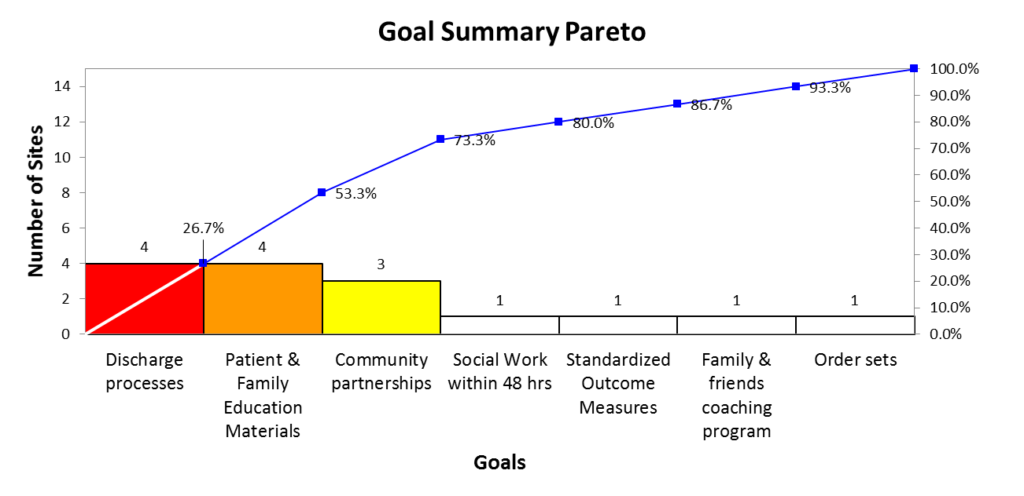
HNHB LHIN TJR Bedded

Slide 79
TJR Bedded: HNHB LHIN Goals and Resources Requested
Goal Summary Pareto
The most cited goals were Discharge Processes, Patient & Family Education Materials and Community Partnerships (73.3% of the cumulative total)
Resources Requested
Coaching program information
Standardized discharge documentation
Patient education resources
Time with the LHIN

Slide 80
TJR Bedded: Provincial Strengths
Patients received individualized assessment and development of an individualized therapy plan
Interventions include exercises to improve active range of motion and strength, and functional training (i.e., gait training; stairs; balance; transfers)
Treatment is provided by a dedicated inter-professional team with general knowledge about TJR assessment and treatment processes
Expected date of discharge is anticipated and discussed with patient and family

Slide 81
TJR Bedded: HNHB LHIN Strengths
Patients received individualized assessment and development of an individualized therapy plan
Goals are established in partnership with the client and their family/caregivers
Interventions include exercises to improve active range of motion and strength and functional training
Treatment is provided by a dedicated interprofessional team with general knowledge about TJR assessment and treatment processes
Pain is assesses with a validated pain measurement tool and treatment is coordinated with pain management
Any TJR precautions are discussed with patient and family
Expected date of discharge is anticipated and discussed with patient and family

Slide 82
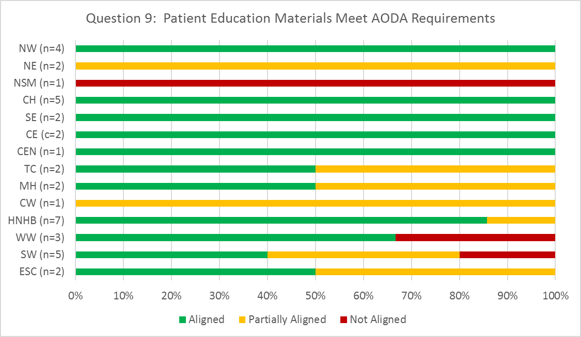
TJR Bedded: Provincial Opportunities
Patient & Family Education
Patient education materials have been developed using plain language and are compliant with the Accessibility for Ontarians with Disabilities Act (AODA) requirements for accessibility

Slide 83
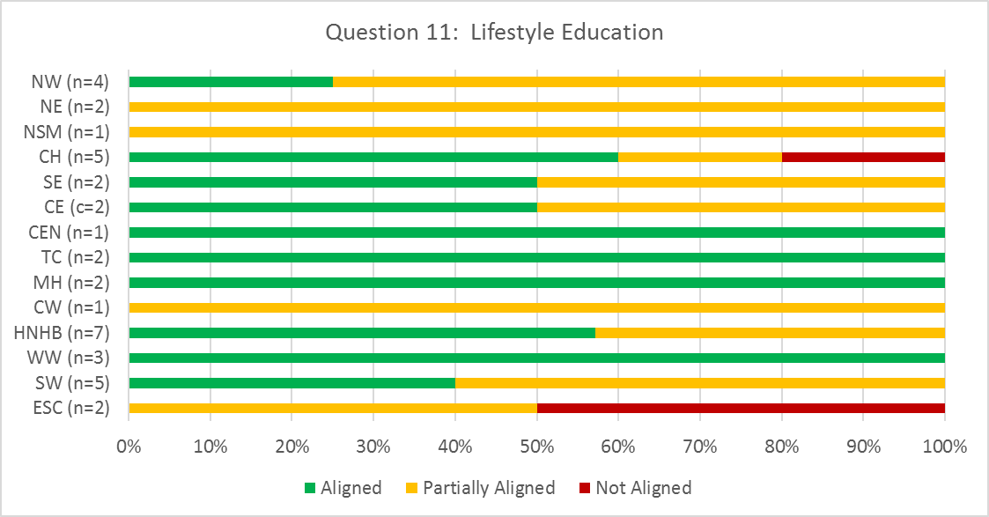
TJR Bedded: Provincial Opportunities
Patient & Family Education
Many patients, who are candidates for hip or knee replacement, present with lifestyle factors that influence outcomes (obesity, lack of exercise, smoking). In such situations, education focused on health promotion, disease prevention and lifestyle changes is provided, or referrals are made to appropriate, available community resources.

Slide 84
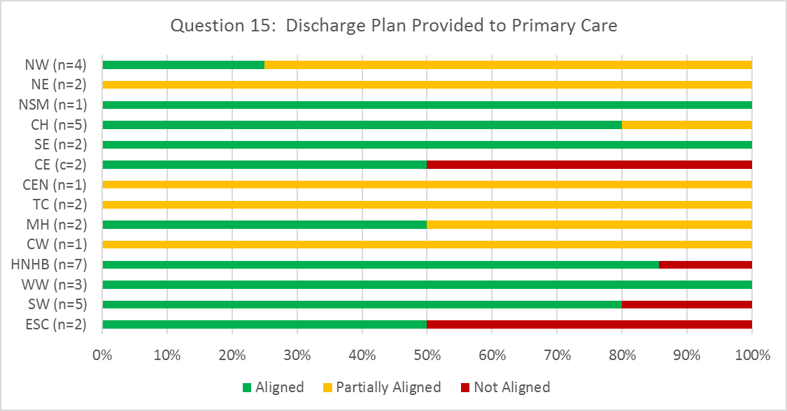
TJR Bedded: Provincial Opportunities
Transition Planning & Care
Written individualized discharge plan are provided to patient's primary care/specialists and the receiving care provider within 24 hours of discharge

Slide 85
TJR Bedded: HNHB LHIN Opportunities
Least aligned best practices
Outcome measures include both performance measures and patient report measures
Where appropriate, education focused on health promotion, disease prevention and lifestyle changes is provided, or referrals are made to appropriate, available community resources.
Referrals for ongoing rehabilitative care are made, and appointment confirmed, prior to discharge

Slide 86
TJR Bedded: Best Practice Implementation Strategies
Addressing Provincial Opportunities for Improvement: High Performer Strategies
Patient & family education
Align Engage Program in Convalescent Care – lectures and materials include lifestyle modification information¹
Lifestyle modification education provided in Intake Clinic or by surgeon^{3, 5}
Videos providing education reviewed with patients and available on website for patients/families⁵
Ortho Surgical Passport Booklet/ Admission package and discharge summary provided^{5,} ⁶
Early mobilization
Abductor canal blocks allowing mobilization Day 0²
Anterior approach THR allowing potential discharge Day 1²
Patients not catheterized intraoperatively. Ambulation to washroom Day 0.³
Physiotherapy Day 0³
¹Dundurn Place Convalescent Care
²Brant Community Health Centre
³Cambridge Memorial Hospital
⁴Grand River Hospital
⁵Peterborough Regional Health Centre
⁶Providence Care

Slide 87
TJR Bedded: Best Practice Implementation Strategies (continued)
Multimodal pain management led by Department of Anesthesia and support by a Nurse Practitioner³
Total Joint Replacement Clinical Nurse Specialist⁴
Therapy coverage during off hours. For example, changing a physiotherapist’s work day to 1400-2200 to provide evening coverage and PT/OT weekend coverage^{2, 4}
Transition planning
LHIN Home & Community Care contacts patient prior to surgery to advise on equipment and physiotherapy follow up³
Blaylock score in pre-op identifies previous functional status and potential barriers for discharge⁴
¹Dundurn Place Convalescent Care
²Brant Community Health Centre
³Cambridge Memorial Hospital
⁴Grand River Hospital
⁵Peterborough Regional Health Centre
⁶Providence Care

Slide 88
TJR Ambulatory: Provincial Priorities for Improvement
LHIN | ESC (1) | SW (1) | WW (n=2) |  | HNHB (n=2) |  | CW | MH (n=2) |  | TC (n=6) |  |  |  |  |  | CE (1) | SE (n=5) |  |  |  |  | CH (n=5) |  |  |  |  | NSM (1) | NE (n=2) |  | NW (n=4) |  |  |  | Multi (1)
Assessment | Well Aligned | Well Aligned | Well Aligned | Well Aligned | Well Aligned | Well Aligned | Well Aligned | Well Aligned | Well Aligned | Well Aligned | Well Aligned | Well Aligned | Well Aligned | Well Aligned | Well Aligned | Well Aligned | Well Aligned | Well Aligned | Well Aligned | Well Aligned | Well Aligned | Well Aligned | Well Aligned | Well Aligned | Well Aligned | Well Aligned | Priority for Improvement | Well Aligned | Well Aligned | Well Aligned | Well Aligned | Well Aligned | Well Aligned | Well Aligned
Treatment | Well Aligned | Well Aligned | Well Aligned | Well Aligned | Well Aligned | Well Aligned | Well Aligned | Well Aligned | Well Aligned | Well Aligned | Well Aligned | Well Aligned | Well Aligned | Well Aligned | Well Aligned | Well Aligned | Well Aligned | Well Aligned | Well Aligned | Well Aligned | Well Aligned | Well Aligned | Well Aligned | Well Aligned | Well Aligned | Well Aligned | Well Aligned | Well Aligned | Well Aligned | Well Aligned | Well Aligned | Well Aligned | Well Aligned | Well Aligned
Patient & Family Education | Priority for Improvement | Well Aligned | Well Aligned | Well Aligned | Well Aligned | Well Aligned | Well Aligned | Well Aligned | Well Aligned | Well Aligned | Well Aligned | Well Aligned | Priority for Improvement | Well Aligned | Well Aligned | Well Aligned | Well Aligned | Well Aligned | Well Aligned | Well Aligned | Well Aligned | Well Aligned | Well Aligned | Well Aligned | Well Aligned | Well Aligned | Priority for Improvement | Well Aligned | Well Aligned | Well Aligned | Well Aligned | Well Aligned | Well Aligned | Well Aligned
Transition Planning | Well Aligned | Well Aligned | Well Aligned | Well Aligned | Well Aligned | Well Aligned | Well Aligned | Well Aligned | Well Aligned | Well Aligned | Well Aligned | Well Aligned | Well Aligned | Well Aligned | Well Aligned | Well Aligned | Well Aligned | Well Aligned | Well Aligned | Well Aligned | Well Aligned | Well Aligned | Well Aligned | Well Aligned | Well Aligned | Well Aligned | Priority for Improvement | Well Aligned | Well Aligned | Well Aligned | Well Aligned | Well Aligned | Well Aligned | Well Aligned
*MultiLHIN organization providing services in HNHB LHIN included in analysis

Slide 89
TJR Ambulatory: Provincial Goals & Resources Analysis
Goal Summary
The most cited goal was Patient Education Materials (22.1% of cumulative total)
Resources
The highest resource requested was Staffing Resources and Funding (27.6% of the cumulative total)
See Appendix A for Pareto Diagrams

Slide 90
TJR Ambulatory: HNHB LHIN Goals and Resources Requested
Short Term Goals
Falls programs and BONEFIT staff education
Patient & family education materials
Standardized patient report measures
Mid-Range Goals
AODA compliant patient & family education materials and program
Lifestyle modification education
Progressive resistance exercise programs
Long Term Goals
Funding
Partnership with Home & Community Care
Resources
Exercise prescription with sufficient intensity

Slide 91
TJR Ambulatory: Provincial Strengths
Interventions include exercises to improve active range of motion and strength and functional training (i.e., gait training; stairs; balance; transfers
Pain is assessed using a validated pain measurement tool (e.g., VAS, NPRS)
Rehab is provided by or supervised by a regulated health professional with clinical experience in TJR rehab

Slide 92
TJR Ambulatory: HNHB LHIN Strengths
Validated measurement tools are used to complete individualized assessment of safety at home, physical and functional abilities and ADL/IADL management
Goals are established in partnership with the client and their family/caregivers
Interventions include exercises to improve active range of motion and strength and functional training
Pain is assessed using a validated pain measurement tool
Rehab is provided by or supervised by a regulated health professional with clinical experience in TJR rehab
Patients are provided exercises and functional activities which can be completed at home
Expected date of discharge is anticipated and discussed, patients are discharged when they have achieved their discharge goals and referrals to community resources/programs are completed

Slide 93
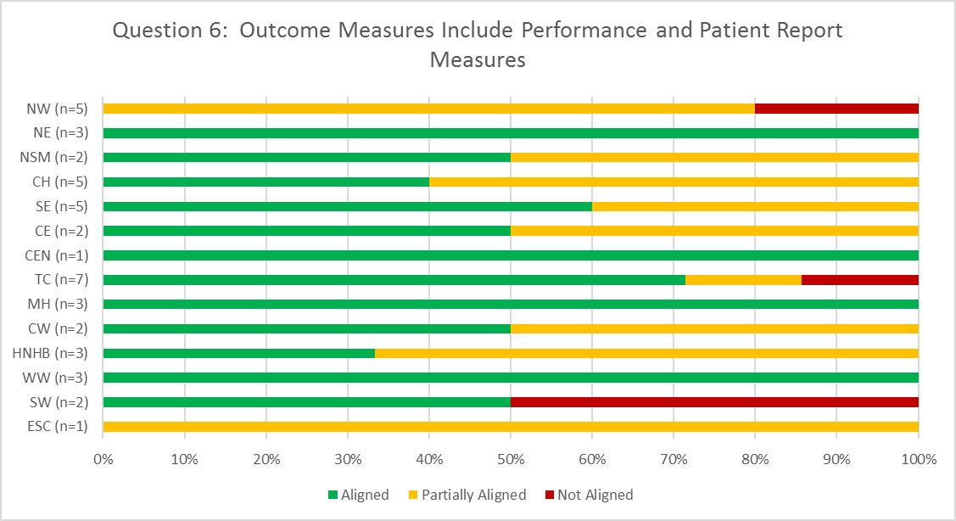
TJR Ambulatory: Provincial Opportunities
Treatment
Outcome measures include both performance measures (e.g. TUG; BERG) and patient report measures (Western Ontario and McMaster Universities Osteoarthritis Index [WOMAC]; Lower Extremity Functional Scale [LEFS])

Slide 94
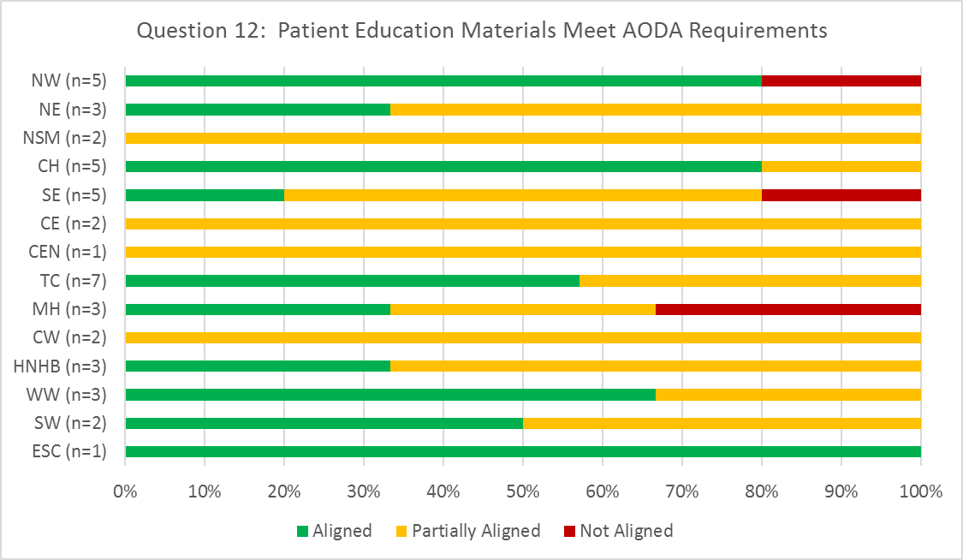
TJR Ambulatory: Provincial Opportunities
Patient & Family Education
Patient education materials have been developed using plain language and are compliant with the Accessibility for Ontarians with Disabilities Act (AODA) requirements for accessibility

Slide 95
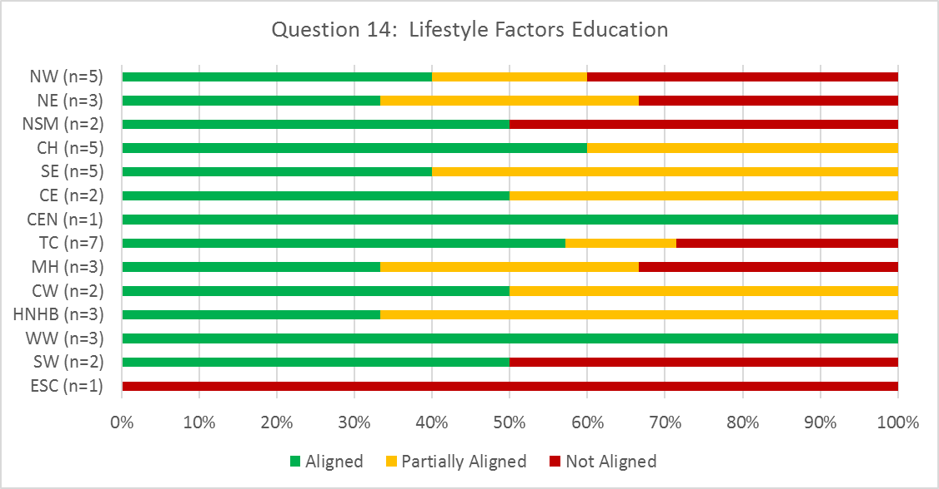
TJR Ambulatory: Provincial Opportunities
Patient & Family Education
Many patients, who are candidates for hip or knee replacement, present with lifestyle factors that influence outcomes (obesity, lack of exercise, smoking).In such situations, education focused on health promotion, disease prevention and lifestyle changes is provided, or referrals are made to appropriate, available community resources.

Slide 96
TJR Ambulatory: HNHB LHIN Opportunities
Least aligned best practices
Rehab for total knee replacement should commence within 7 days of discharge from acute care
Rehab for total hip replacement should commence approximately 2 - 6 weeks following discharge from acute care
Outcome measures include both performance measures and patient report measures
Patient education materials have been developed using plain language and are compliant with the Accessibility for Ontarians with Disabilities Act (AODA) requirements for accessibility
When appropriate, education focused on health promotion, disease prevention and lifestyle changes is provided, or referrals are made to appropriate, available community resources.

Slide 97
TJR Ambulatory: Best Practice Implementation Strategies
Addressing Provincial Opportunities for Improvement: High Performer Strategies
Patient & family education:
Provided via classes, 1:1, patient guide, post-op exercise booklet and mobile app^{1, 2, 3}
Education includes managing meaningful tasks while adhering to hip precautions and lifestyle modification²
Education is reviewed and updated regularly with changes in practice and evidence³
Comprehensive fall prevention screening initiative – all patients 65+ years complete the “Staying Independent Checklist”. Those who score at risk receive education from the health practitioner and are encouraged to see their primary care practitioner¹
¹Pembroke Regional Hospital
²Providence Healthcare
³Sunnybrook Health Science Centre

Slide 98
TJR Ambulatory: Best Practice Implementation Strategies (continued)
Outcome measures utilized^{1, 2, 3}:
LEFS
TUG
COPM
Numeric Pain Scale
2 minute walk test
1 RM leg press
Stair test
P4
PSFS
Therapists are BONEFIT certified²
Process in place to maintain consensus among surgeons regarding post-surgical care to create consistent evidence-based care³
¹Pembroke Regional Hospital
²Providence Healthcare
³Sunnybrook Health Science Centre

Slide 99
TJR In Home: Provincial Priorities for Improvement
LHIN | SW (n=2) |  | WW (n=3) |  |  | HNHB (n=1) | CW (n=1) | TC (n=1) | CE (n=2) |  | SE (n=2) |  | CH (n=2) |  | NE (n=1) | NW (n=5) |  |  |  |  | Multi (n=3)
Assessment | Well Aligned | Well Aligned | Well Aligned | Well Aligned | Well Aligned | Well Aligned | Well Aligned | Well Aligned | Well Aligned | Well Aligned | Well Aligned | Well Aligned | Well Aligned | Well Aligned | Well Aligned | Well Aligned | Well Aligned | Well Aligned | Well Aligned | Well Aligned | Well Aligned | Well Aligned | Well Aligned
Treatment | Well Aligned | Well Aligned | Well Aligned | Well Aligned | Well Aligned | Well Aligned | Well Aligned | Well Aligned | Well Aligned | Well Aligned | Well Aligned | Well Aligned | Well Aligned | Well Aligned | Well Aligned | Well Aligned | Well Aligned | Well Aligned | Well Aligned | Well Aligned | Well Aligned | Well Aligned | Well Aligned
Patient & Family Education | Well Aligned | Well Aligned | Well Aligned | Well Aligned | Well Aligned | Well Aligned | Well Aligned | Well Aligned | Well Aligned | Well Aligned | Well Aligned | Well Aligned | Well Aligned | Well Aligned | Well Aligned | Well Aligned | Well Aligned | Well Aligned | Well Aligned | Well Aligned | Well Aligned | Well Aligned | Well Aligned
Transition Planning | Well Aligned | Well Aligned | Well Aligned | Well Aligned | Well Aligned | Well Aligned | Well Aligned | Well Aligned | Well Aligned | Well Aligned | Well Aligned | Well Aligned | Well Aligned | Well Aligned | Well Aligned | Well Aligned | Well Aligned | Well Aligned | Well Aligned | Well Aligned | Well Aligned | Well Aligned | Well Aligned
*MultiLHIN organizations providing services in HNHB LHIN included in analysis

Slide 100
TJR In-Home: Provincial Goals & Resources Analysis
Goal Summary
The most cited goal was Standard Outcome Measures (25% of cumulative total)
Resources
The highest resource requested was Standard Outcome Measures (46.2% of the cumulative total)
See Appendix A for Pareto Diagrams

Slide 101
TJR In-Home: HNHB LHIN Goals and Resources Requested
Short Term Goals
Staff education
Performance and patient reported outcome measures
Mid-Range Goals
AODA compliant patient & family education materials
Lifestyle factors education resources
Long Term Goals
Advocate for home therapy with funders
Develop electronic tool kit
Resources
Performance and patient reported outcome measures

Slide 102
TJR In-Home: Provincial Strengths
Goals are established in partnership with the client and their family/caregivers
Patients are encouraged and empowered to self-manage their care, as appropriate
Equipment and/or assistive devices are prescribed, as appropriate, to assist with independence, safety and function
Pain management is integrated into patient care, to allow active participation in rehabilitation
Patients and families are provided with education on safe activity resumption, mobility and precautions (as applicable), expected progress, pain management, and community supports/resources
Expected date of discharge is anticipated and discussed with patient and family
If patient’s personal goals exceed the those of a the rehab program and a home exercise program, patients are supported in exploring community resources/exercise programs that best meet his/her needs

Slide 103
TJR In-Home: HNHB LHIN Strengths
Validated measurement tools are used to complete individualized assessment
Goals are established in partnership with the client and their family/caregivers
Direct OT and/or PT services should commence within 7 days of discharge from acute care
Treatment includes hands-on & manual therapy techniques, self-management, prescription of equipment and/or assistive devices
Pain is assessed using a validated pain measurement tool and is integrated into patient care
Patients and family are provided with education on safe activity resumption, mobility, precautions, expected progress, pain management and community supports

Slide 104
TJR In-Home: HNHB LHIN Strengths (continued)
A self-management component should be included in the treatment plan to empower patients to continue exercise post-discharge; patient education includes information regarding the benefits of ongoing independent participation in exercise
Expected date of discharge is anticipated and discussed with patient and family
If patient’s personal goals exceed the those of a the rehab program and a home exercise program, patients are supported in exploring community resources/exercise programs that best meet his/her needs
Referrals to community resources/programs, as appropriate

Slide 105
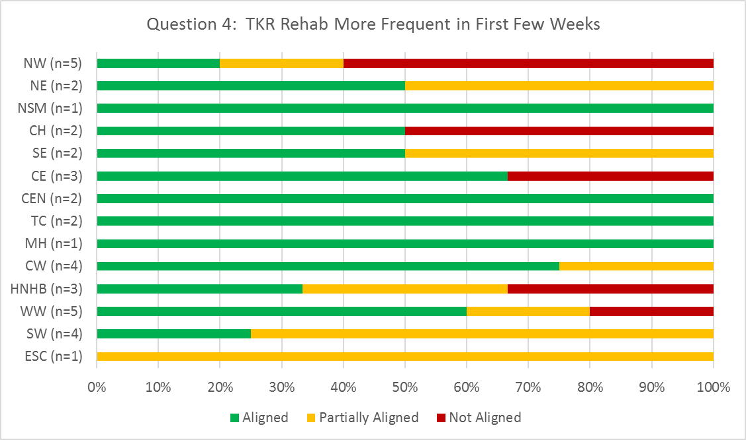
TJR In-Home: Provincial Opportunities
Treatment
For total knee replacement, rehab is more frequent for the first few weeks (2-3/week) in order to prevent contracture and loss of range of motion

Slide 106
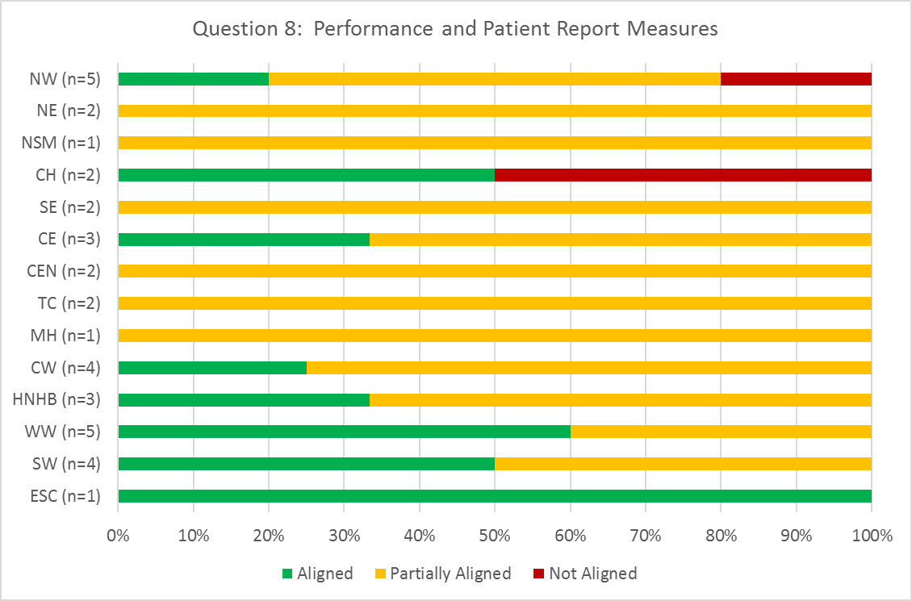
TJR In-Home: Provincial Opportunities
Treatment
Outcome measures include both performance measures (e.g. TUG; BERG) and patient report measures (Western Ontario and McMaster Universities Osteoarthritis Index [WOMAC]; Lower Extremity Functional Scale [LEFS])

Slide 107
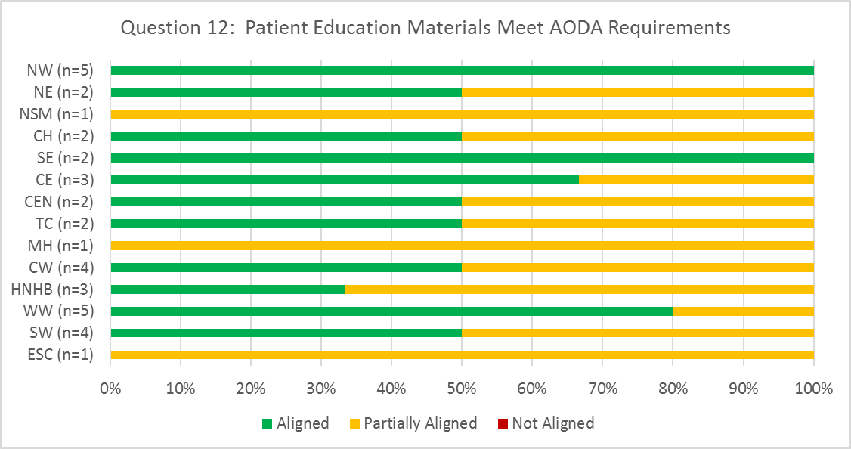
TJR In-Home: Provincial Opportunities
Patient & Family Education
Patient education materials have been developed using plain language and are compliant with the Accessibility for Ontarians with Disabilities Act (AODA) requirements for accessibility

Slide 108
TJR In-Home: HNHB LHIN Opportunities
Least aligned best practices
For total knee replacement, rehab is more frequent for the first few weeks (2-3/week) in order to prevent contracture and loss of range of motion
Outcome measures include both performance measures (e.g. TUG; BERG) and patient report measures (Western Ontario and McMaster Universities Osteoarthritis Index [WOMAC]; Lower Extremity Functional Scale [LEFS])
Patient education materials have been developed using plain language and are compliant with the Accessibility for Ontarians with Disabilities Act (AODA) requirements for accessibility

Slide 109
TJR In-Home: Best Practice Implementation Strategies
Addressing Provincial Opportunities for Improvement: High Performer Strategies
Patient & family education:
LHIN-wide regional education booklet for hip and knee surgery (http://regionalhealthprogramsww.com/PatientEducationMaterial?deptID=2)
CoHealth App in process to provide patients with information and planning for surgery
Best practice standard document for all aspects of the care pathway (http://regionalhealthprogramsww.com/HealthCareProviders/CarePathways/TotalJointArthroplasty?deptID=2)
Outcome measures (http://regionalhealthprogramsww.com/HealthCareProviders?deptID=2)
Transition planning:
Patients are seen in home and clinic by the same physiotherapist
LHIN Home & Community Care team calls patients 6 weeks prior to surgery to facilitate transition planning and preparations
Waterloo-Wellington LHIN Home & Community Care

Slide 110
Summary

Slide 111
Overall Provincial Summary
Analysis based on 247 Self-Assessment Submissions
Common Areas of Strength:
Individualized treatment interventions
Patient and caregiver engagement
Dedicated inter-professional team in pre-op, bedded, in-home and LTC sectors
Goal-directed plan of care
Common Opportunities for Improvement:
Patient and family education materials
Communication across the continuum of care
Use of validated outcome measures and risk assessment tools
Hip Fracture: Addressing dementia, delirium and depression
TJR: Addressing pre-operative supports

Slide 112
HNHB LHIN Summary
A total of 43 self-assessments were received from 21 organizations in the HNHB LHIN (including 2 MultiLHIN organizations)
All health care sectors were assessed
Common Areas of Strength:
Individualized treatment interventions
Patient and caregiver engagement
Hip Fracture: Fall prevention & management
TJR: Pain assessment & management and goal directed care
Common Opportunities for Improvement:
Hip Fracture: Osteoporosis Management
TJR: Performance & patient report outcome measures

Slide 113
Contact Information
For questions, contact:
Gabrielle Sadler, RCA Project Manager
Gabrielle.sadler@uhn.ca

Slide 114
Appendix A: Provincial Goal Summary and Resources Pareto Diagrams

Slide 115
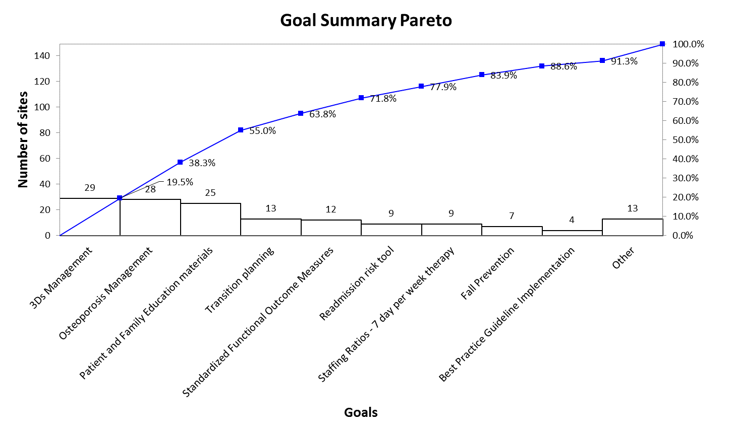
Hip Fracture Bedded
Notes:
No statistically significant vital few, but top organizational goals align with heat map.

Slide 116
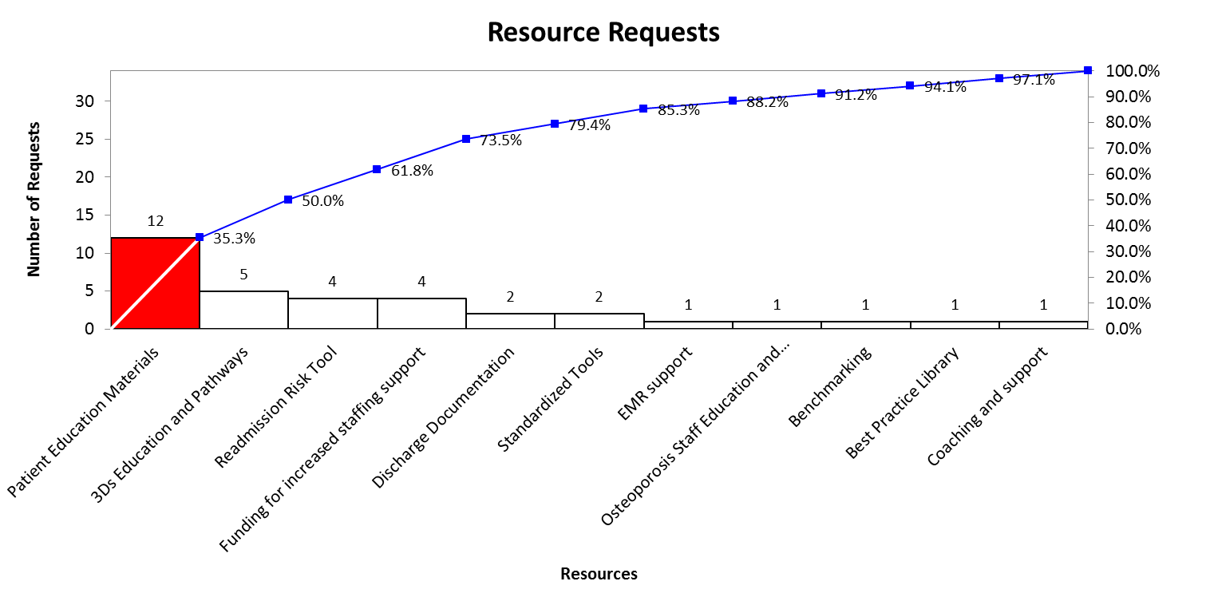
Hip Fracture Bedded
Notes:
Patient Education was the second top priority for Bedded Rehab.

Slide 117
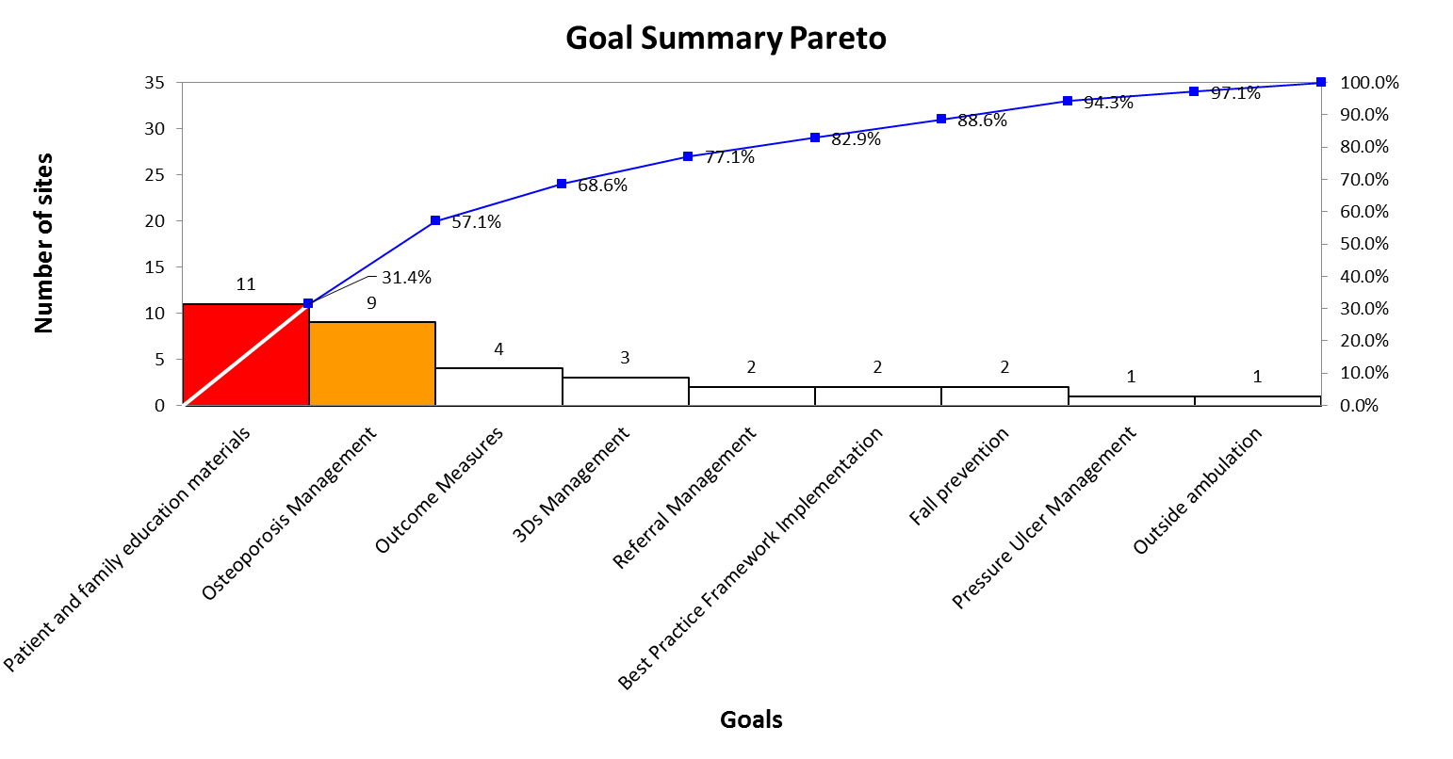
Hip Fracture Ambulatory
Notes:
Looking for the vital few. The highlighted bars represent greater than 20% of the cumulative line and help to separate these vital few.
This diagram represents the short, mid-range and long term goals wrapped up.
This pareto is based on the goals outlined by each organization. Interestingly, the heat map suggests that the priority area should be 3Ds, but organizations concentrating on education materials. Patient education materials are a low hanging fruit, potentially.

Slide 118
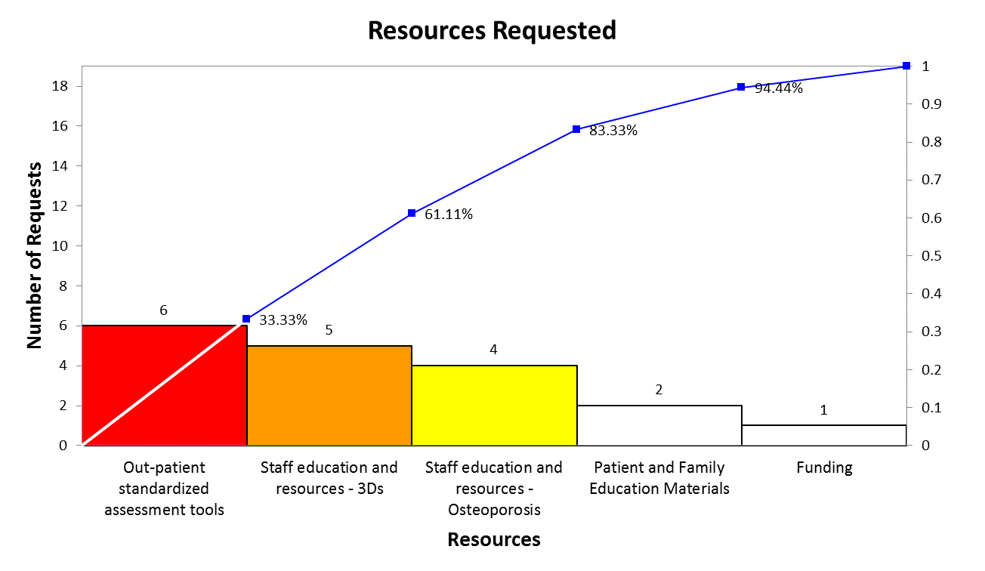
Hip Fracture Ambulatory
Notes:
These are the resources requested by the organizations.

Slide 119
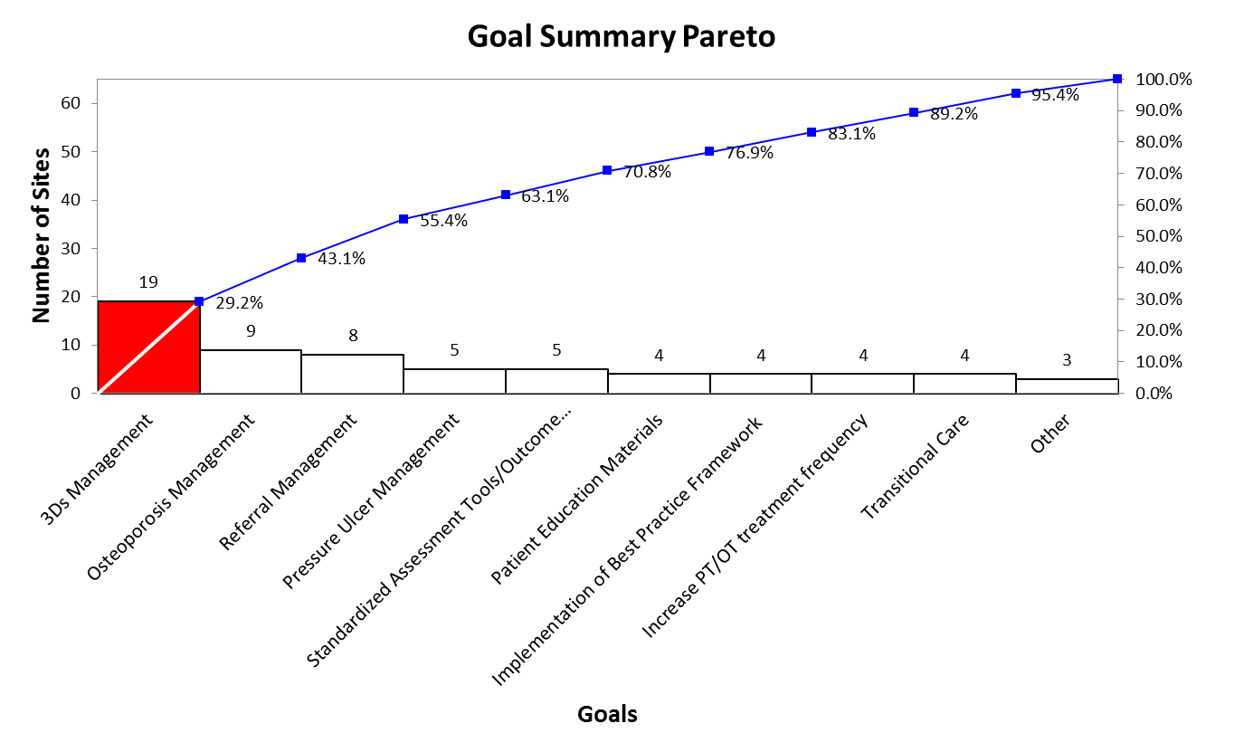
Hip Fracture In-Home
Notes:
Organizational alignment with heat map – 3Ds Management

Slide 120
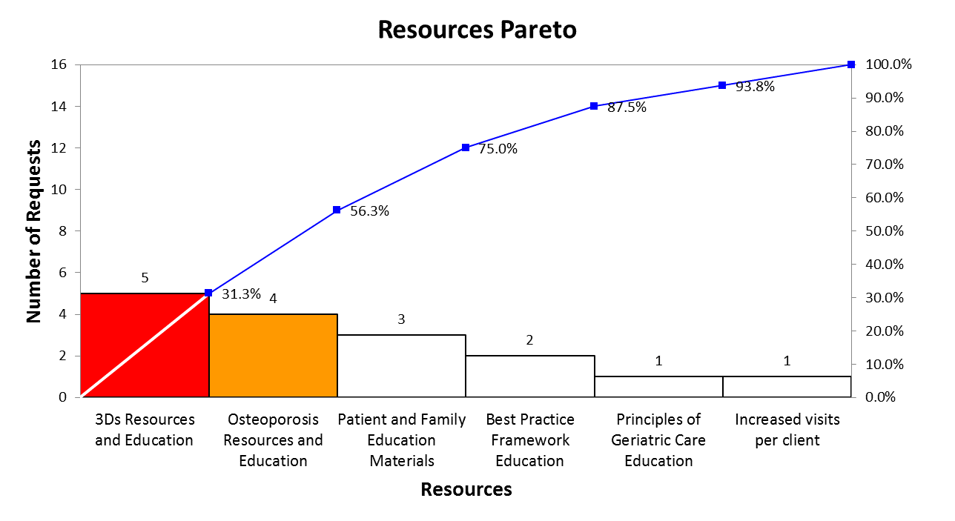
Hip Fracture In-Home
Notes:
Resources alignment

Slide 121
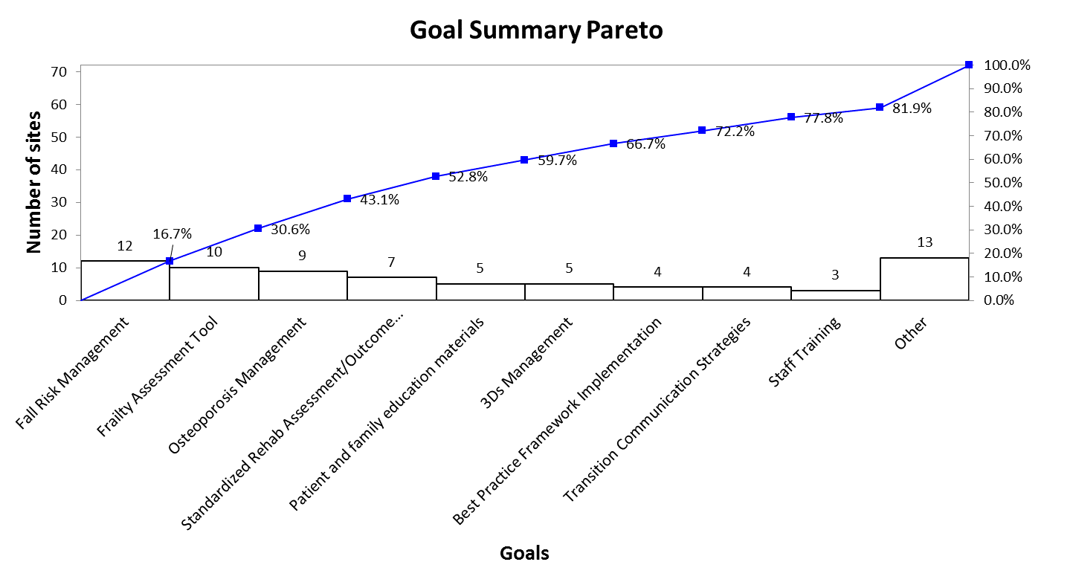
Hip Fracture LTC
Notes:
No significant vital few emerge from goal summary

Slide 122
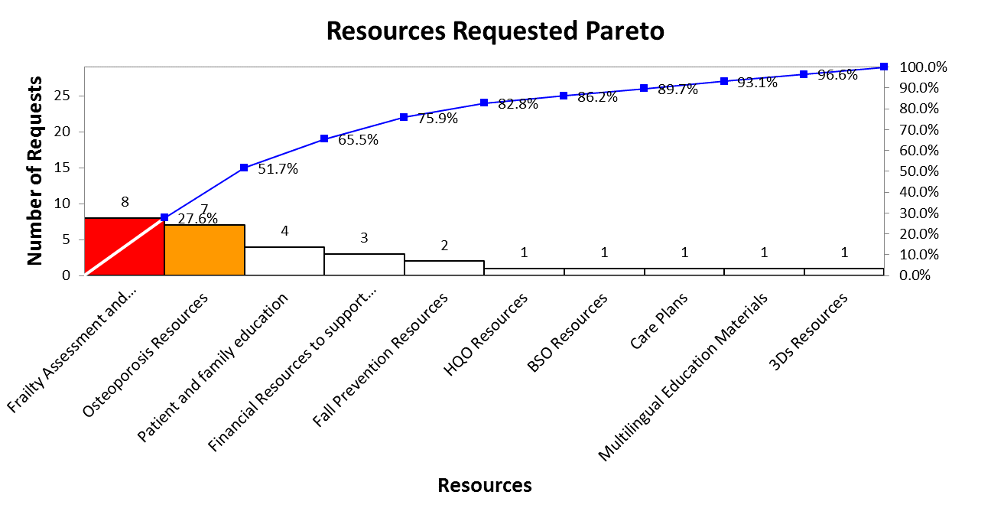
Hip Fracture LTC
Notes:
Frailty Assessment and Intervention Strategies

Slide 123
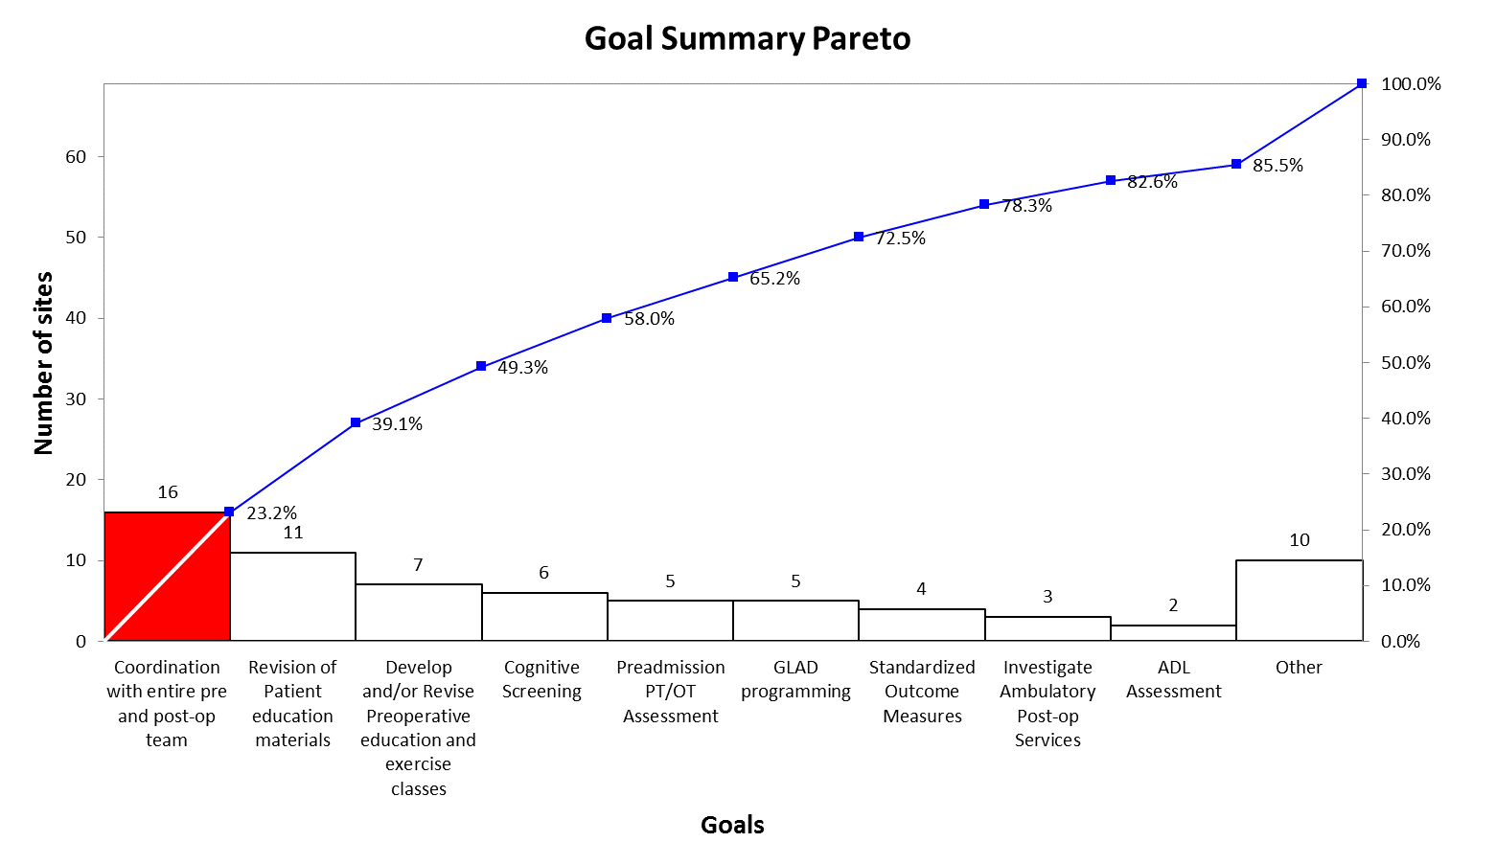
TJR Pre-op

Slide 124
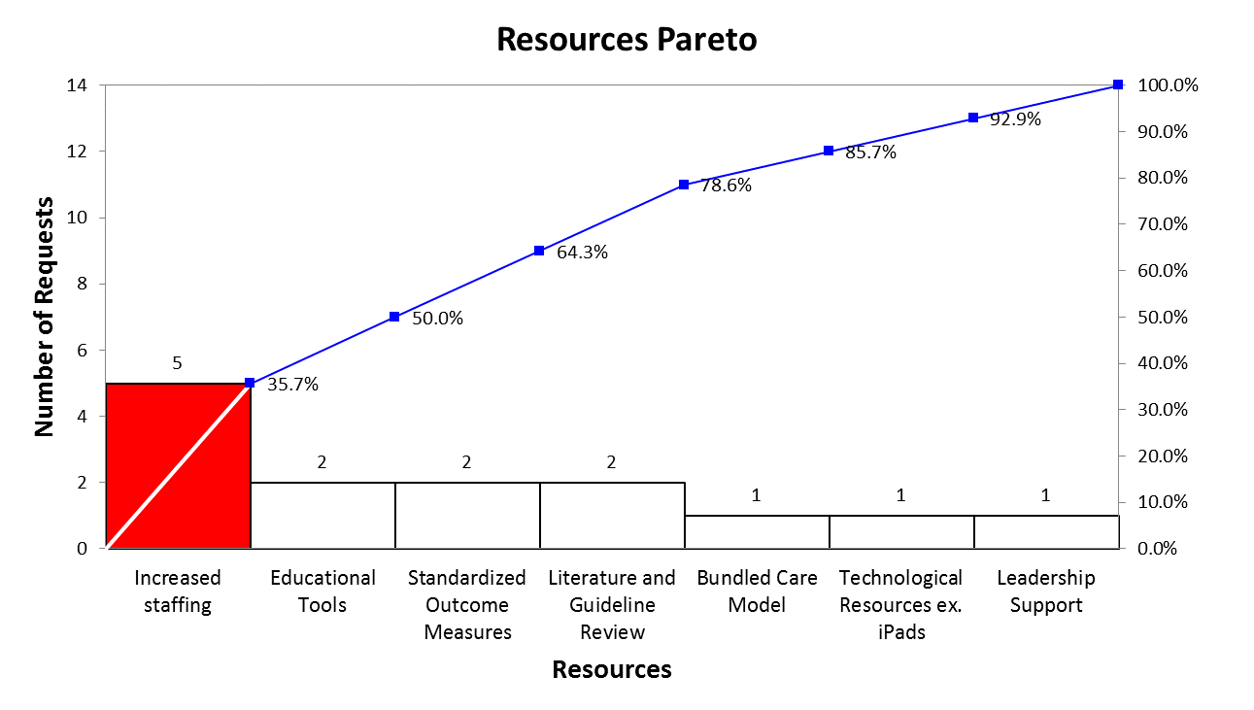
TJR Pre-op

Slide 125
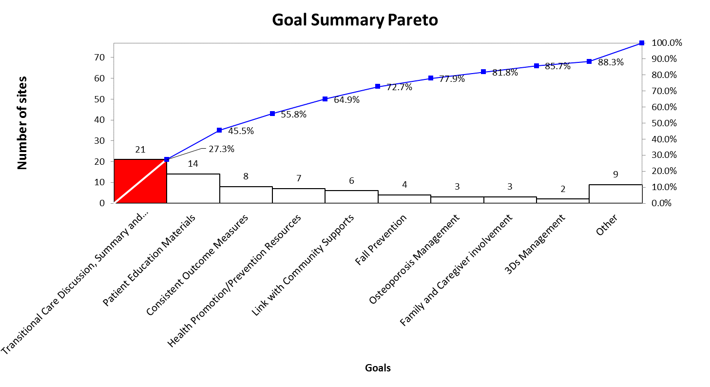
TJR Bedded
Notes:
Transitional care discussion, summary and referrals.

Slide 126
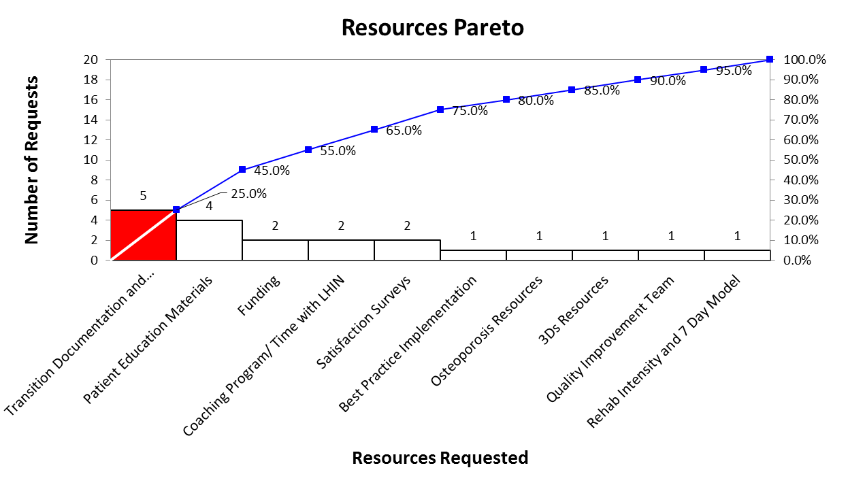
TJR Bedded
Notes:
Transition Documentation and Referrals.
Organizational concentration on transitional care.

Slide 127
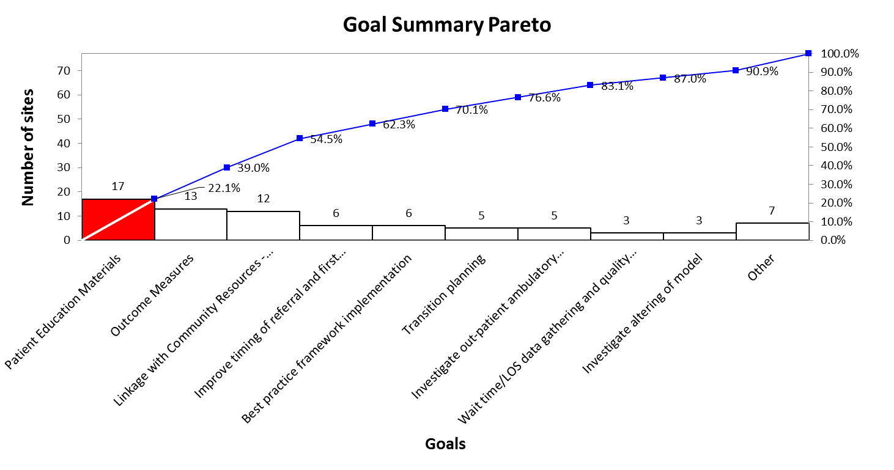
TJR Ambulatory
Notes:
Aligned with priority area on heat map

Slide 128
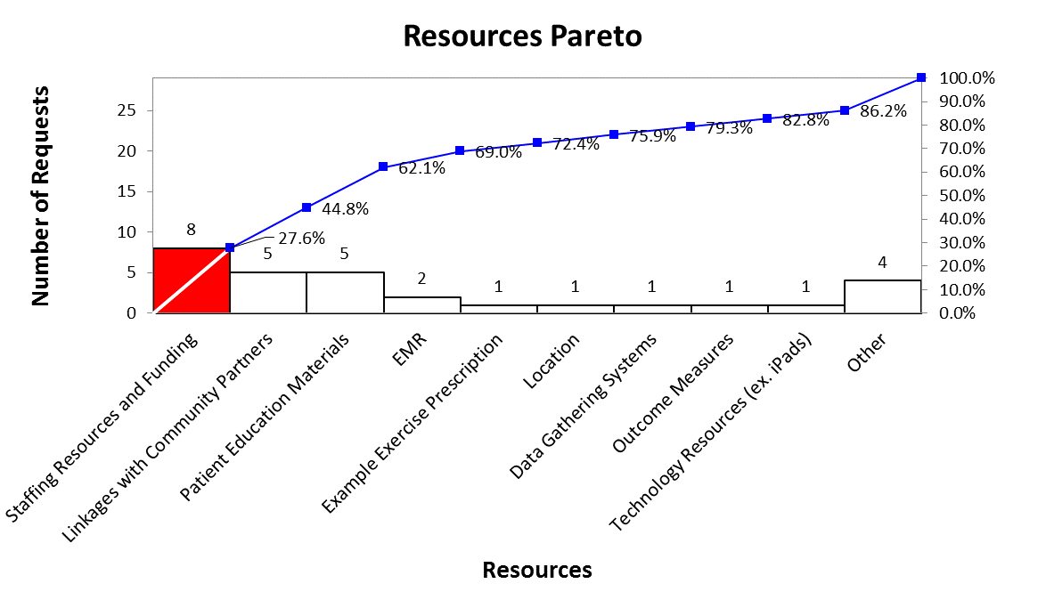
TJR Ambulatory

Slide 129
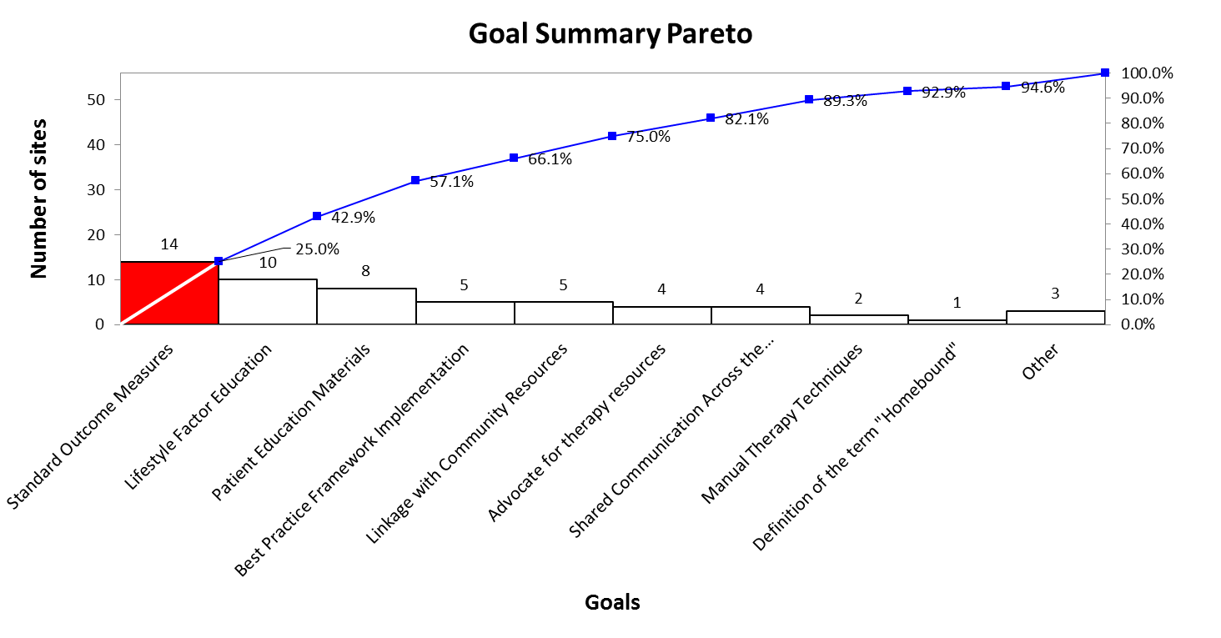
TJR In-Home

Slide 130
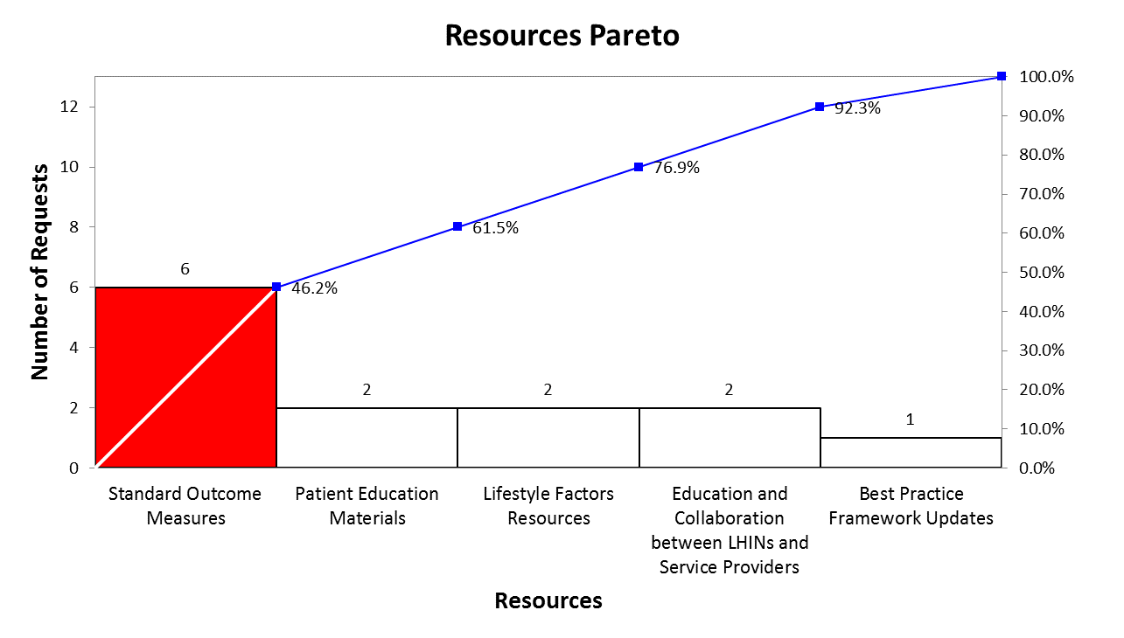
TJR In-Home
Notes:
Resources and goals aligned

